Slide 1
LEASE LIAISON MEETING
April 28, 2014
1:30 – 5:00 PM

Slide 2
Agenda
Introductions (New Staff)
Annual Data Validation
Tenant Broker Contracts
Emergency Leases
Energy Performance Analysis (EPA)
Invitation to Negotiate (ITN)
Building Owners and Managers Association (BOMA)
Standard Lease Agreement
Net Present Value (NPV)
Florida Facilities Pool (FFP)
Tenant Improvements (TI)
DMS Regional Leasing Contacts
Questions

Slide 3
Agency State-Owned and
Leased Facility Data:
Annual Validation for FY 2013-14
Statutory Authority for Data Request
Subsection 216.0152(1), Florida Statutes
Section 216.0153, Florida Statutes
Subsection 252.385(4), Florida Statutes
Section 255.249, Florida Statutes
Introductions
Annual Data Validation
Tenant Broker Contracts
Emergency Leases
Energy Performance Analysis
Invitation to Negotiate
Building Owners and Managers Association
Lease Agreement
Net Present Value
Florida Facilities Pool
Tenant Improvements
DMS Regional Leasing Contacts
Questions

Slide 4
Data Reporting Expectations
Introductions
Annual Data Validation
Tenant Broker Contracts
Emergency Leases
Energy Performance Analysis
Invitation to Negotiate
Building Owners and Managers Association
Lease Agreement
Net Present Value
Florida Facilities Pool
Tenant Improvements
DMS Regional Leasing Contacts
Questions
Due Date | What to Submit | How To Submit | Contact Person
Friday, May 30, 2014 | Completed Agency Lease Inventory Overview Spreadsheet (template provided by DMS) Indication of any leased facility that is suitable as an emergency shelter | Via email to Philip Cobb at: Philip.Cobb@dms.myflorida.com | DMS Strategic Planning Staff
Friday, May 30, 2014 | Any agency-owned facility that may be used as potential emergency shelter | FL-SOLARIS FITS Application (flag) | Agency FL-SOLARIS FITS Account Manager
Monday, June 30, 2014 | Agency Owned and Leased Portfolio Management Plan (template provided by DMS) | Via email to Philip Cobb at: Philip.Cobb@dms.myflorida.com | DMS Strategic Planning Staff
Monday, June 30, 2014 | Updated owned facility data, including recording any new facilities | FL-SOLARIS FITS Application | Agency FL-SOLARIS FITS Account Manager
Monday, June 30, 2014 | Identification of any owned facility considered a disposition candidate | FL-SOLARIS FITS Application (flag) | Agency FL-SOLARIS FITS Account Manager

Slide 5
Questions for DMS may be directed to:
Introductions
Annual Data Validation
Tenant Broker Contracts
Emergency Leases
Energy Performance Analysis
Invitation to Negotiate
Building Owners and Managers Association
Lease Agreement
Net Present Value
Florida Facilities Pool
Tenant Improvements
DMS Regional Leasing Contacts
Questions
Name | Phone | Email
Inman Hartsfield | (850) 488-0081 | Inman.Hartsfield@dms.myflorida.com
Arlisha Roberts | (850) 413-0033 | Arlisha.Roberts@dms.myflorida.com
Sue Early | (850) 413-9578 | Sue.Early@dms.myflorida.com

Slide 6
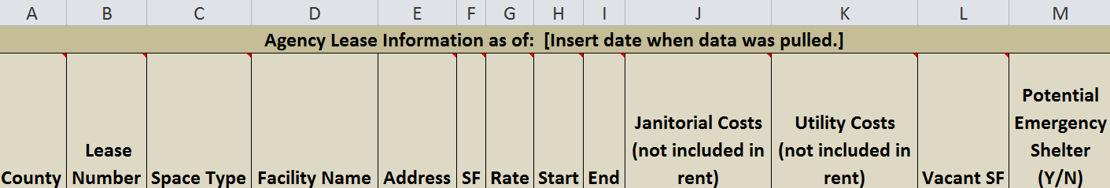
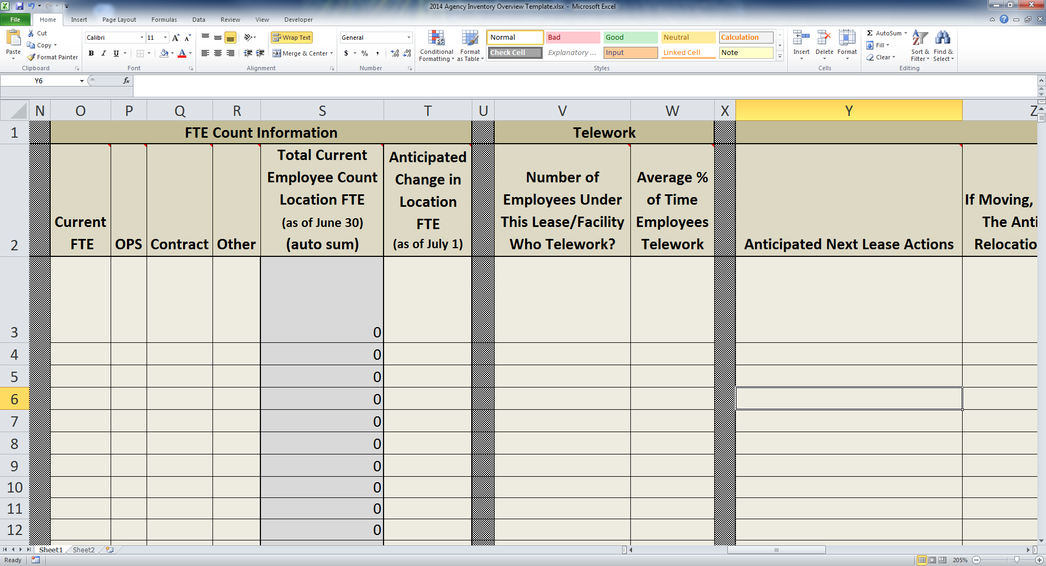
Agency Lease Inventory Overview
Spreadsheet Template
Introductions
Annual Data Validation
Tenant Broker Contracts
Emergency Leases
Energy Performance Analysis
Invitation to Negotiate
Building Owners and Managers Association
Lease Agreement
Net Present Value
Florida Facilities Pool
Tenant Improvements
DMS Regional Leasing Contacts
Questions
Agency Lease Information
Full-Time Equivalent (FTE) Count Information

Slide 7
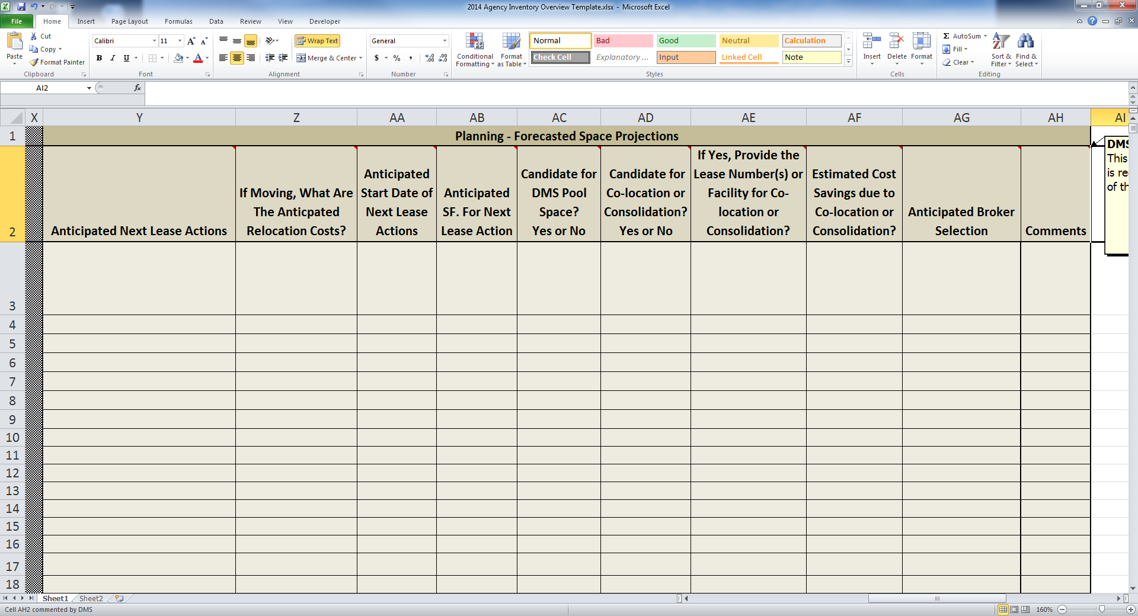
Agency Lease Inventory Overview
Spreadsheet Template
(Continued)
Introductions
Annual Data Validation
Tenant Broker Contracts
Emergency Leases
Energy Performance Analysis
Invitation to Negotiate
Building Owners and Managers Association
Lease Agreement
Net Present Value
Florida Facilities Pool
Tenant Improvements
DMS Regional Leasing Contacts
Questions
Telework
Forecasted Space Projects

Slide 8
STATE OF FLORIDA
DEPARTMENT OF MANAGEMENT SERVICES
Agency Owned and Leased Portfolio Management Plan Template
(Business Case Analysis)
Date:
Agency:
For Period: fiscal year 2013-14
This Agency-Owned and -Leased Portfolio Management Plan Template, together with the Agency Lease Inventory Overview Spreadsheet, comprises the agency’s portfolio plan for the next fiscal year. All agency leases identified as candidates for co-location or consolidation are indicated in the Agency Lease Inventory Overview Spreadsheet, and narrative descriptions are set forth below. This year, we are asking all agencies to submit one Portfolio Management Plan that includes all of their leases.
I. Overview (Provide a brief summary describing the agency’s methodology and considerations in evaluating and selecting candidates for co-location or consolidation);
Introductions
Annual Data Validation
Tenant Broker Contracts
Emergency Leases
Energy Performance Analysis
Invitation to Negotiate
Building Owners and Managers Association
Lease Agreement
Net Present Value
Florida Facilities Pool
Tenant Improvements
DMS Regional Leasing Contacts
Questions

Slide 9
STATE OF FLORIDA
DEPARTMENT OF MANAGEMENT SERVICES
Agency Owned and Leased Portfolio Management Plan Template
(Business Case Analysis)
(CONTINUED)
II. Future Environment & Anticipated Needs
Describe agency leased space goals and strategies (as they support strategies in the agency’s Long Range Program Plan);
Give a general description of any known workforce changes affecting the agency’s delivery of services (such as legislative/budget changes, teleworking or alternative workplace programs, etc.);
Identify potential changes in client and/or business needs (changes in agency’s service delivery models, client services or client traffic impacting space needs).
Introductions
Annual Data Validation
Tenant Broker Contracts
Emergency Leases
Energy Performance Analysis
Invitation to Negotiate
Building Owners and Managers Association
Lease Agreement
Net Present Value
Florida Facilities Pool
Tenant Improvements
DMS Regional Leasing Contacts
Questions

Slide 10
STATE OF FLORIDA
DEPARTMENT OF MANAGEMENT SERVICES
Agency Owned and Leased Portfolio Management Plan Template
(Business Case Analysis)
(CONTINUED)
III. Co-Location Recommendations/Cost-Benefit Analysis/Telework Program
Agency leases identified as co-location or consolidation candidates are as indicated in Column AD of the Agency Lease Inventory Overview Spreadsheet.
The agency has conducted a cost benefit analysis in relation to leases identified as co-location or consolidation candidates in Column AD of the Agency Lease Inventory Overview Spreadsheet and the estimated cost savings associated therewith are shown in Column AF.
Please note, in determining potential cost savings to be derived as a result of any proposed co-locations or consolidations, the agency can utilize its own, internal savings calculation method or DMS’ Cost Benefit Analysis Template located here:
http://www.dms.myflorida.com/content/download/85940/487095/version/1/file/County+Summary+and+Co-location+Cost-Benefit+Analysis+V2.xlsx
Introductions
Annual Data Validation
Tenant Broker Contracts
Emergency Leases
Energy Performance Analysis
Invitation to Negotiate
Building Owners and Managers Association
Lease Agreement
Net Present Value
Florida Facilities Pool
Tenant Improvements
DMS Regional Leasing Contacts
Questions

Slide 11
STATE OF FLORIDA
DEPARTMENT OF MANAGEMENT SERVICES
Agency Owned and Leased Portfolio Management Plan Template
(Business Case Analysis)
(CONTINUED)
In calculating savings, the agency must consider anticipated changes in total space size, rate changes, moving costs and impacts on operating costs (such as data and communications, office equipment, security services, special equipment and other items specific to the unit’s core business process). Agencies are not required to submit their detailed calculations of potential savings in this regard, but should retain copies for future reference.
Indicate below whether or not the agency has a telework program and, if so, identify any agency performance measures that support telework program analysis.
Introductions
Annual Data Validation
Tenant Broker Contracts
Emergency Leases
Energy Performance Analysis
Invitation to Negotiate
Building Owners and Managers Association
Lease Agreement
Net Present Value
Florida Facilities Pool
Tenant Improvements
DMS Regional Leasing Contacts
Questions

Slide 12
System Enhancements Phase I
Introductions
Annual Data Validation
Tenant Broker Contracts
Emergency Leases
Energy Performance Analysis
Invitation to Negotiate
Building Owners and Managers Association
Lease Agreement
Net Present Value
Florida Facilities Pool
Tenant Improvements
DMS Regional Leasing Contacts
Questions
FIELD CHANGES
Remove | Vacant Workstations
Add | Net Leasable SF and Available/Underutilized SF
Remove | Location FTEs
Add | Current FY FTE, OPS, Contract and Other. Auto-sum Total Occupants field.
Add | Telework Component: Number of FTE who Telework and Average % of Time
Add | Yes/No radio button for records that will pass to People First (future connection)
Add | Yes/No radio button for Potential Emergency Shelter designation
Mark Required | Other Revenue, Total Utility Cost and Operating Cost fields
FUNCTIONALITY CHANGES
Search | Make default search return only records that are either “Active” or “Candidate for Disposition.”
Comments (New Tab) | Move comment field to a new tab that will allow agencies to enter multiple comments. Allow Account Managers and/or comment author the ability to delete a comment.
Deficiency Information | Provide the ability to track actual cost of repair, status of repair and fiscal year deficiency reported, and to maintain a historical account of what was spent on the facility in order to determine Life Cycle cost to the state. Provide the ability to track deleted deficiencies (i.e., do not delete the record, but instead mark it as inactive while maintaining search capability.
FL-SOLARIS ID for Lease Data | Modify so that the lease upload does not show a different FL-SOLARIS ID# for the same lease uploaded each night.

Slide 13
System Enhancements Phase I (continued)
Introductions
Annual Data Validation
Tenant Broker Contracts
Emergency Leases
Energy Performance Analysis
Invitation to Negotiate
Building Owners and Managers Association
Lease Agreement
Net Present Value
Florida Facilities Pool
Tenant Improvements
DMS Regional Leasing Contacts
Questions
FUNCTIONALITY CHANGES
Data Upload | Allow users to upload information via a comma separated value (*.CSV) file or Excel (*.XLS) spreadsheet. Include the following fields in the upload capability/template: FL-SOLARIS Facility # (Primary Key) Net Leasable Square Footage Available Square Footage Current Fiscal Year FTE Current Fiscal Year OPS Current Fiscal Year Contract Current Fiscal Year Other Number of FTE who Telework Average % of Time Teleworking Total Number of Leases Recorded for this Facility Total Square Footage Leased from the Facility Tenant List Total Revenue Generated from Leases Parking Revenue Other Revenue Total Utility Cost Operating Cost Taxroll ID Taxroll Structure Value Taxroll Land Value Taxroll Assessment Year Agency Comments

Slide 14
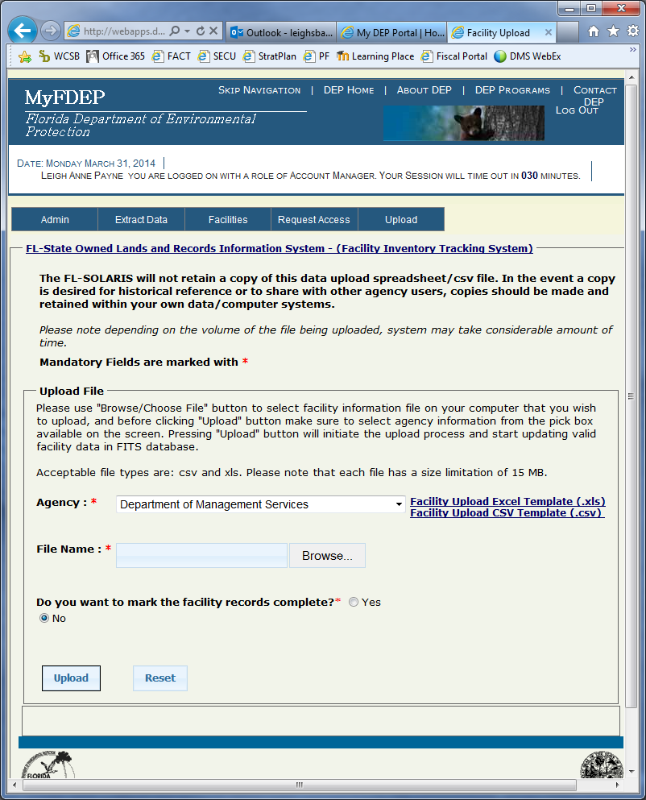
Screen Shot of Data Upload Field
Introductions
Annual Data Validation
Tenant Broker Contracts
Emergency Leases
Energy Performance Analysis
Invitation to Negotiate
Building Owners and Managers Association
Lease Agreement
Net Present Value
Florida Facilities Pool
Tenant Improvements
DMS Regional Leasing Contacts
Questions

Slide 15
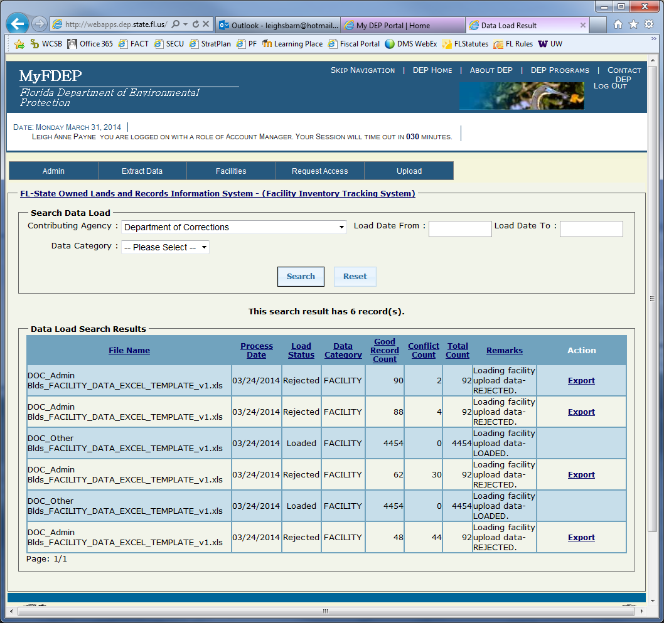
Screen Shot of Data Upload Error Screen
Introductions
Annual Data Validation
Tenant Broker Contracts
Emergency Leases
Energy Performance Analysis
Invitation to Negotiate
Building Owners and Managers Association
Lease Agreement
Net Present Value
Florida Facilities Pool
Tenant Improvements
DMS Regional Leasing Contacts
Questions

Slide 16
Future System Enhancements, Phase II
(expected May 15, 2014)
Introductions
Annual Data Validation
Tenant Broker Contracts
Emergency Leases
Energy Performance Analysis
Invitation to Negotiate
Building Owners and Managers Association
Lease Agreement
Net Present Value
Florida Facilities Pool
Tenant Improvements
DMS Regional Leasing Contacts
Questions
COSMETIC / NAVIGATION CHANGES
“Back to Facilities List” button | Add to Edit/View/Create Facilities screen at top of page (in addition to bottom). Add to Edit/View/Create Campus screen at top of page (in addition to bottom).
Edit/View Campus Screen | Add Agency Name.
Splash Screen | Remind users that information entered into FL-SOLARIS FITS is public record.
FUNCTIONALITY CHANGES
Search | Add the ability to search by address.
Data Extract File | Add Latitude/Longitude coordinates to the extract file. Refresh extract columns to be consistent with field changes in Phase I Revise the archive file naming convention to be FY2013-14 rather than 2013.
Add Historical Data Tab | Keep and display all historical data for all fields that are reset July 1.
Add Land Tab | Display all associated land information for the parcel on which the facility reside.
Transfer DOR Taxroll Information Automatically | Note: This enhancement is being replaced by the ability to perform data extracts without duplication of FL-SOLARIS ID numbers in the results.

Slide 17
Tenant Broker Contracts
New contracts have been executed and posted:
DMS12/13-007A - CBRE, Inc.
DMS12/13-007B - Vertical Integration
Introductions
Annual Data Validation
Tenant Broker Contracts
Emergency Leases
Energy Performance Analysis
Invitation to Negotiate
Building Owners and Managers Association
Lease Agreement
Net Present Value
Florida Facilities Pool
Tenant Improvements
DMS Regional Leasing Contacts
Questions

Slide 18
In addition to an approved RSN, an agency must issue a purchase order accompanied by either:
a completed Engagement Checklist for each leasing transaction with performance dates clearly identified; or
Scope of Work that has clear performance expectations, deliverables and timelines for delivery.
Introductions
Annual Data Validation
Tenant Broker Contracts
Emergency Leases
Energy Performance Analysis
Invitation to Negotiate
Building Owners and Managers Association
Lease Agreement
Net Present Value
Florida Facilities Pool
Tenant Improvements
DMS Regional Leasing Contacts
Questions

Slide 19
What is new in the contracts:
Lower commission amounts;
Fixed rates for IMA’s and BOV’s;
Post-lease execution requirements; and
Various price options for balance of line items.
Introductions
Annual Data Validation
Tenant Broker Contracts
Emergency Leases
Energy Performance Analysis
Invitation to Negotiate
Building Owners and Managers Association
Lease Agreement
Net Present Value
Florida Facilities Pool
Tenant Improvements
DMS Regional Leasing Contacts
Questions

Slide 20
Tenant Broker Contracts
Introductions
Annual Data Validation
Tenant Broker Contracts
Emergency Leases
Energy Performance Analysis
Invitation to Negotiate
Building Owners and Managers Association
Lease Agreement
Net Present Value
Florida Facilities Pool
Tenant Improvements
DMS Regional Leasing Contacts
Questions
Type of Lease Agreement Negotiated | Maximum Compensation Rate
New leases | Total Annual Rent of Maximum the Base Term of the Lease Rate $ 0 - $ 500,000 3.50% $ 500,001 - $2,500,000 3.25% $ 2,500,001 - $4,500,000 3.00% $ 4,500,001 - $6,499,999 2.75% $ 6,500,000 and over 2.50%
Lease renewal, lease modifications, stay-in-place lease, lease extension, lease expansion | 2% of the rent to be paid for the term of the particular lease renewal, modification, extension, expansion, or stay-in-place negotiated.
All leases for warehouse, hangar or storage space | 2% of the sum of the annual rent to be paid over the initial term of the lease for leases 0-5,000 square feet Leases over 5,000 square feet follow the new lease chart above.

Slide 21
In addition to transaction services, other general real estate services may be purchased from this contract.
Agencies must create Scope of Work for which the brokers will provide quotes.
These projects may be fee based (lump sum), hourly rates (as indicated in the contracts) or negotiated commission rates.
Introductions
Annual Data Validation
Tenant Broker Contracts
Emergency Leases
Energy Performance Analysis
Invitation to Negotiate
Building Owners and Managers Association
Lease Agreement
Net Present Value
Florida Facilities Pool
Tenant Improvements
DMS Regional Leasing Contacts
Questions

Slide 22
Form FM4065 Commission Agreement has been updated.
The new commission agreement with the correct commission amounts listed will soon be available on our website; please use this new commission agreement.
Introductions
Annual Data Validation
Tenant Broker Contracts
Emergency Leases
Energy Performance Analysis
Invitation to Negotiate
Building Owners and Managers Association
Lease Agreement
Net Present Value
Florida Facilities Pool
Tenant Improvements
DMS Regional Leasing Contacts
Questions

Slide 23
Emergency Leases (255.25(10), F.S.) are leases for space approved without a competitive bid that meet the following criteria:
The space is destroyed or rendered uninhabitable by an act of God, fire, malicious destruction, structural failure or legal action; OR
The agency head certifies in writing that there is an immediate danger to the public health, safety or welfare; AND
The lease cannot exceed 11 months. Lack of planning does not constitute an emergency lease.
Introductions
Annual Data Validation
Tenant Broker Contracts
Emergency Leases
Energy Performance Analysis
Invitation to Negotiate
Building Owners and Managers Association
Lease Agreement
Net Present Value
Florida Facilities Pool
Tenant Improvements
DMS Regional Leasing Contacts
Questions

Slide 24
Energy Performance Analysis (EPA)
Statutory Requirements
Subsection 255.254(1), Florida Statutes
“No state agency shall lease, construct, or have constructed, within limits prescribed in this section, a facility without having secured from the department an evaluation of life-cycle costs based on sustainable building ratings.”
Paragraph 255.257(4)(b), Florida Statutes
“No state agency shall enter into new leasing agreements for office space that does not meet Energy Star building standards, except when the appropriate state agency head determines that no other viable or cost-effective alternative exists.”
Introductions
Annual Data Validation
Tenant Broker Contracts
Emergency Leases
Energy Performance Analysis
Invitation to Negotiate
Building Owners and Managers Association
Lease Agreement
Net Present Value
Florida Facilities Pool
Tenant Improvements
DMS Regional Leasing Contacts
Questions

Slide 25
Energy Performance Analysis (EPA)
Program Requirements
Energy Star Rating:
Must be 50 or higher
Can be based on utility bills if the space is separately metered and 12 months of bills are available
Must otherwise be based on a computer-based simulation
Introductions
Annual Data Validation
Tenant Broker Contracts
Emergency Leases
Energy Performance Analysis
Invitation to Negotiate
Building Owners and Managers Association
Lease Agreement
Net Present Value
Florida Facilities Pool
Tenant Improvements
DMS Regional Leasing Contacts
Questions

Slide 26
Energy Performance Analysis (EPA)
Program Requirements
Low Energy Star Ratings:
A computer-based simulation is necessary to demonstrate proposed building modifications that will raise the Energy Star rating to 50 or higher.
Introductions
Annual Data Validation
Tenant Broker Contracts
Emergency Leases
Energy Performance Analysis
Invitation to Negotiate
Building Owners and Managers Association
Lease Agreement
Net Present Value
Florida Facilities Pool
Tenant Improvements
DMS Regional Leasing Contacts
Questions

Slide 27
Energy Performance Analysis (EPA)
Program Requirements
Computer-Based Simulations:
Must be performed by a professional engineer
Must meet industry-standard requirements
Introductions
Annual Data Validation
Tenant Broker Contracts
Emergency Leases
Energy Performance Analysis
Invitation to Negotiate
Building Owners and Managers Association
Lease Agreement
Net Present Value
Florida Facilities Pool
Tenant Improvements
DMS Regional Leasing Contacts
Questions

Slide 28
Energy Performance Analysis (EPA)
Program Requirements
Energy Cost Projections:
The cost utilization index ($/SF/Yr) shall be projected over the term of the lease.
The annual energy cost shall be derived from three years of actual utility bills or a computer-based simulation.
Introductions
Annual Data Validation
Tenant Broker Contracts
Emergency Leases
Energy Performance Analysis
Invitation to Negotiate
Building Owners and Managers Association
Lease Agreement
Net Present Value
Florida Facilities Pool
Tenant Improvements
DMS Regional Leasing Contacts
Questions

Slide 29
Energy Performance Analysis (EPA)
Submission Requirements
Please refer to the EPA Addendum for details.
Please email the EPA submissions to DMS Leasing.
Note: We strive to turn EPA submissions around within one business day.
Introductions
Annual Data Validation
Tenant Broker Contracts
Emergency Leases
Energy Performance Analysis
Invitation to Negotiate
Building Owners and Managers Association
Lease Agreement
Net Present Value
Florida Facilities Pool
Tenant Improvements
DMS Regional Leasing Contacts
Questions

Slide 30
The Invitation to Negotiate (ITN) has been updated and is available for use. Updates include:
General clean–up
Removed antenna roof rights
Energy Star language
Introductions
Annual Data Validation
Tenant Broker Contracts
Emergency Leases
Energy Performance Analysis
Invitation to Negotiate
Building Owners and Managers Association
Lease Agreement
Net Present Value
Florida Facilities Pool
Tenant Improvements
DMS Regional Leasing Contacts
Questions

Slide 31
Building Owners and Managers Association (BOMA)
Space standards are no longer applicable to Florida Leases.
Please remove this language from solicitations.
(Rule 60H-2.001, Florida Administrative Code)
Introductions
Annual Data Validation
Tenant Broker Contracts
Emergency Leases
Energy Performance Analysis
Invitation to Negotiate
Building Owners and Managers Association
Lease Agreement
Net Present Value
Florida Facilities Pool
Tenant Improvements
DMS Regional Leasing Contacts
Questions

Slide 32
Standard Lease Agreement
Has been updated (4/2014) to include new Americans with Disabilities Act language.
Please make sure you begin using the new document.
Introductions
Annual Data Validation
Tenant Broker Contracts
Emergency Leases
Energy Performance Analysis
Invitation to Negotiate
Building Owners and Managers Association
Lease Agreement
Net Present Value
Florida Facilities Pool
Tenant Improvements
DMS Regional Leasing Contacts
Questions

Slide 33
Net Present Value (NPV)
Allows us to compare different payout schedules on the same playing field.
What is this lease worth to me today – in today’s dollars?
The discount rate is used to discount future cash flows to the present value and is a key variable in this process.
The discount rate can be found on the approved RSN for a new lease.
We use NPV to compare all offers, and it is included on the quote/bid synopsis.
Introductions
Annual Data Validation
Tenant Broker Contracts
Emergency Leases
Energy Performance Analysis
Invitation to Negotiate
Building Owners and Managers Association
Lease Agreement
Net Present Value
Florida Facilities Pool
Tenant Improvements
DMS Regional Leasing Contacts
Questions

Slide 34
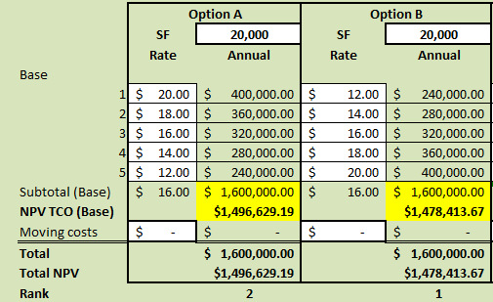
NPV Example
Introductions
Annual Data Validation
Tenant Broker Contracts
Emergency Leases
Energy Performance Analysis
Invitation to Negotiate
Building Owners and Managers Association
Lease Agreement
Net Present Value
Florida Facilities Pool
Tenant Improvements
DMS Regional Leasing Contacts
Questions
Notice the aggregate total (subtotal line) is the same for both options. However, the NPV amount is less for Option B.

Slide 35
NPV continued
In summary, it is important to look at the aggregate (total) cost of a deal since we have to write that check for each individual payment. But when comparing the varied costs over time, the NPV takes into account the time value of money and shows you the cost of any given deal today based on when each payout occurs.
Introductions
Annual Data Validation
Tenant Broker Contracts
Emergency Leases
Energy Performance Analysis
Invitation to Negotiate
Building Owners and Managers Association
Lease Agreement
Net Present Value
Florida Facilities Pool
Tenant Improvements
DMS Regional Leasing Contacts
Questions

Slide 36

FLORIDA FACILITIES POOL (FFP):
113 total structures managed throughout the state of Florida.
72 of these structures are revenue-generating.
Introductions
Annual Data Validation
Tenant Broker Contracts
Emergency Leases
Energy Performance Analysis
Invitation to Negotiate
Building Owners and Managers Association
Lease Agreement
Net Present Value
Florida Facilities Pool
Tenant Improvements
DMS Regional Leasing Contacts
Questions
FFP OCCUPANCY:
Our current occupancy rate is 95%!
It is important to always check with your DMS Leasing Account Manager when looking for space in a particular area so that they can help you find FFP vacancies or compare costs with possible private leases.
CONTACT INFORMATION IS LOCATED ON OUR DMS WEBSITE:
http://www.dms.myflorida.com/business_operations/real_estate_development_and_management/facilities_management/lease_management

Slide 37


TENANT IMPROVEMENT:
Want to add an office? Remove a door? Reconfigure cubicles?
Submit a TI Request Form available on the DMS Website.
Introductions
Annual Data Validation
Tenant Broker Contracts
Emergency Leases
Energy Performance Analysis
Invitation to Negotiate
Building Owners and Managers Association
Lease Agreement
Net Present Value
Florida Facilities Pool
Tenant Improvements
DMS Regional Leasing Contacts
Questions
Need a floor plan to mark-up and send with your TI Request Form?
Contact Erika DeRose, the DMS Leasing-AutoCAD and Interior Designer, at:
erika.derose@dms.myflorida.com

Slide 38

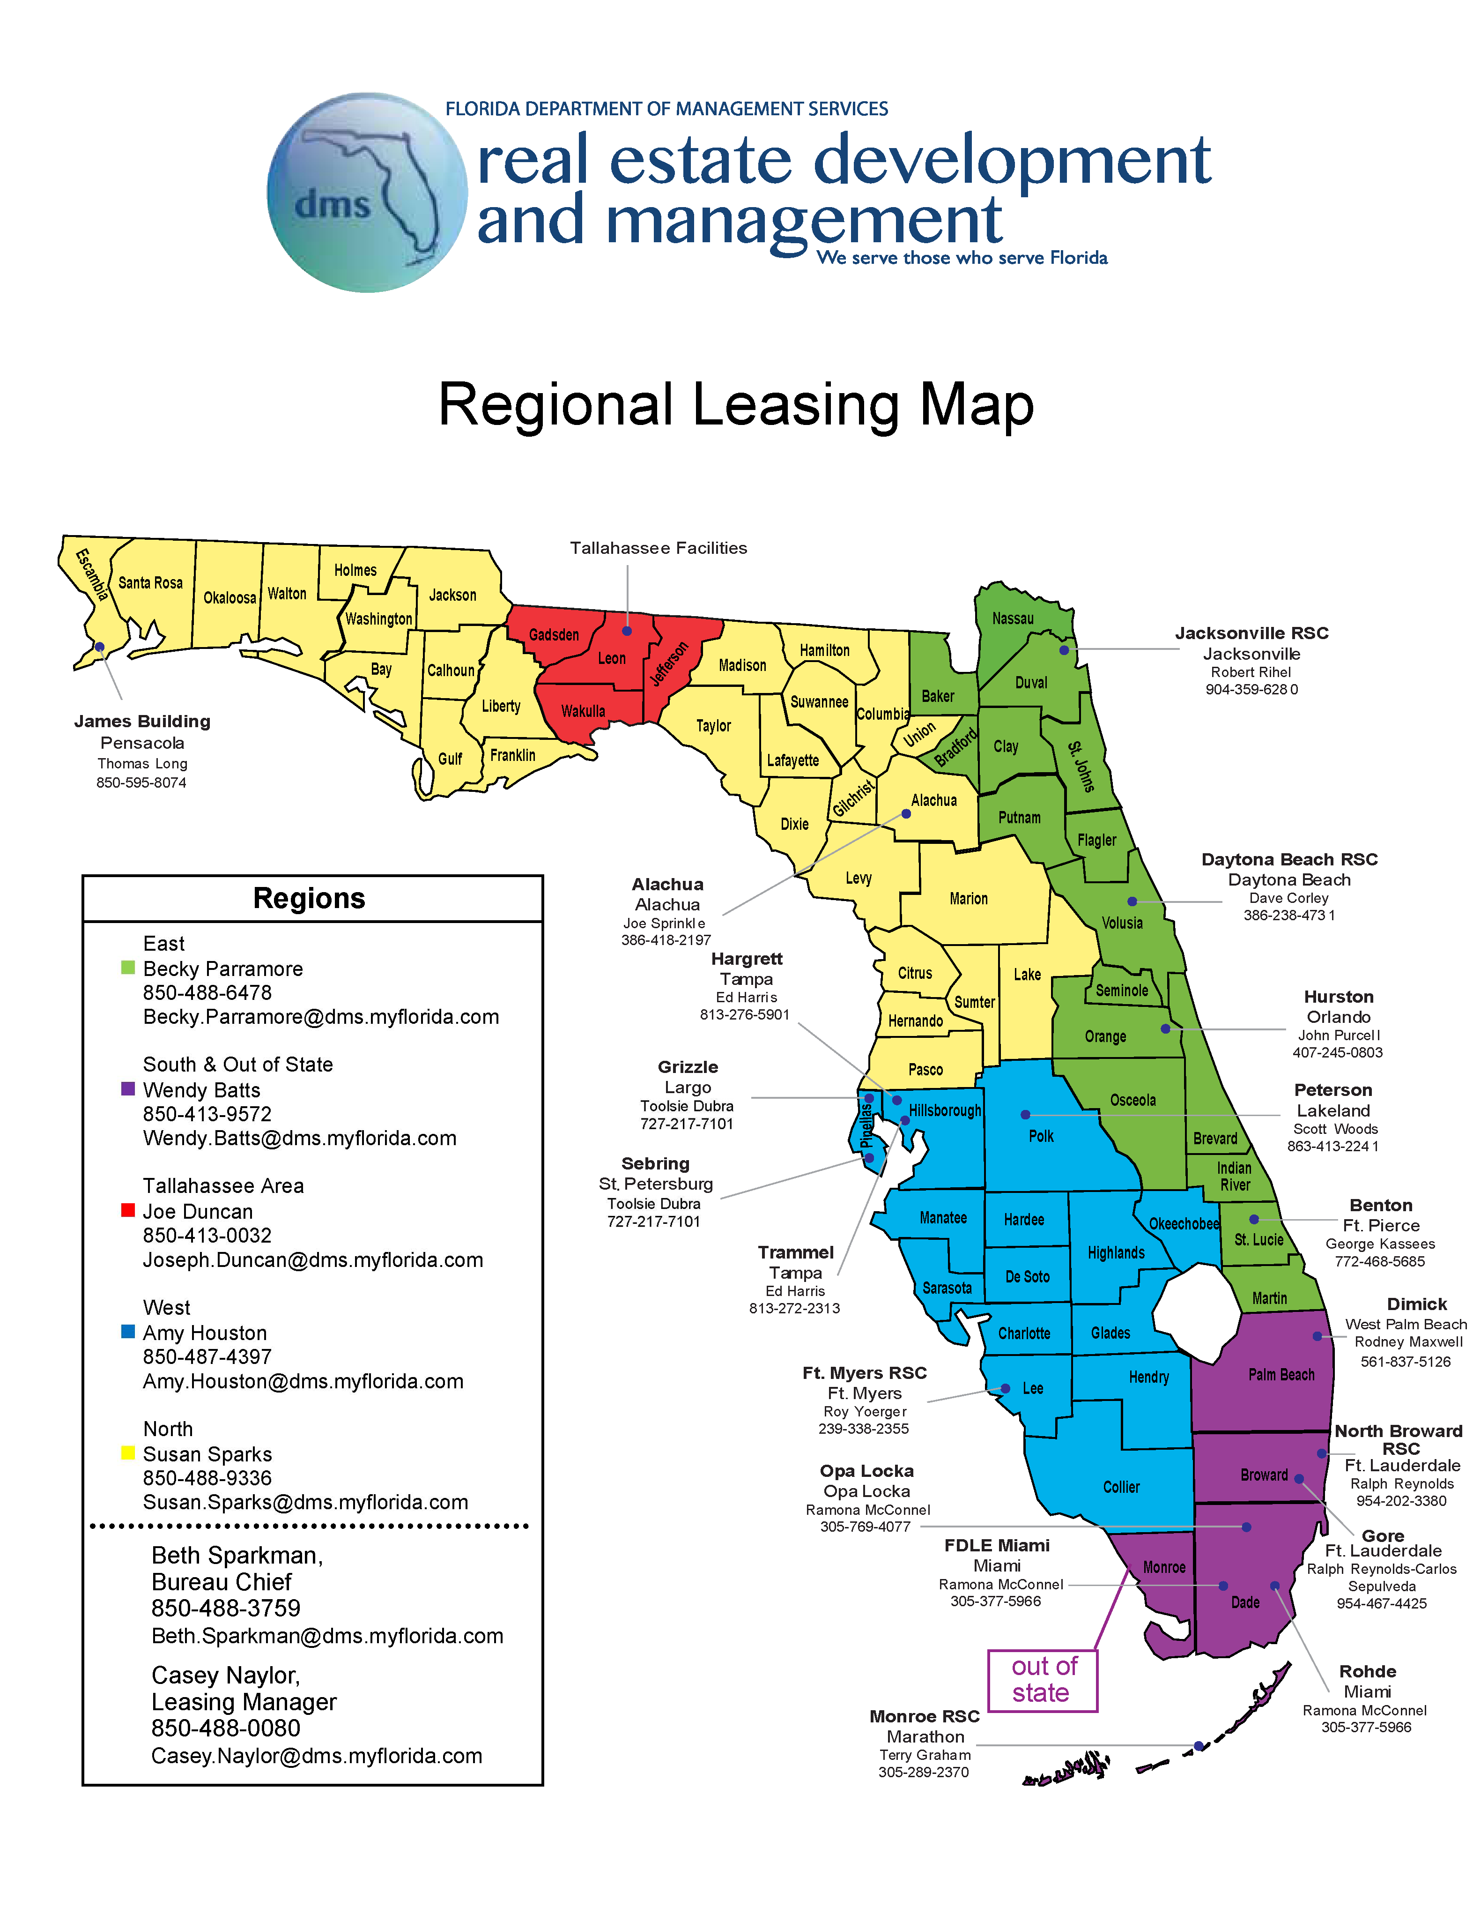

Want to modify your lease to add or subtract space and/or determine the square footage of your area?
Want to add staff and know if more cubicles can be added and stay within code?
OR
Introductions
Annual Data Validation
Tenant Broker Contracts
Emergency Leases
Energy Performance Analysis
Invitation to Negotiate
Building Owners and Managers Association
Lease Agreement
Net Present Value
Florida Facilities Pool
Tenant Improvements
DMS Regional Leasing Contacts
Questions
Contact your DMS account manager, who will then make an AutoCAD design or square foot request.

Slide 39
-Questions-
Introductions
Annual Data Validation
Tenant Broker Contracts
Emergency Leases
Energy Performance Analysis
Invitation to Negotiate
Building Owners and Managers Association
Lease Agreement
Net Present Value
Florida Facilities Pool
Tenant Improvements
DMS Regional Leasing Contacts
Questions

