Slide 1
Division of Telecommunications
Relocating Telecommunication Facilities

Slide 2
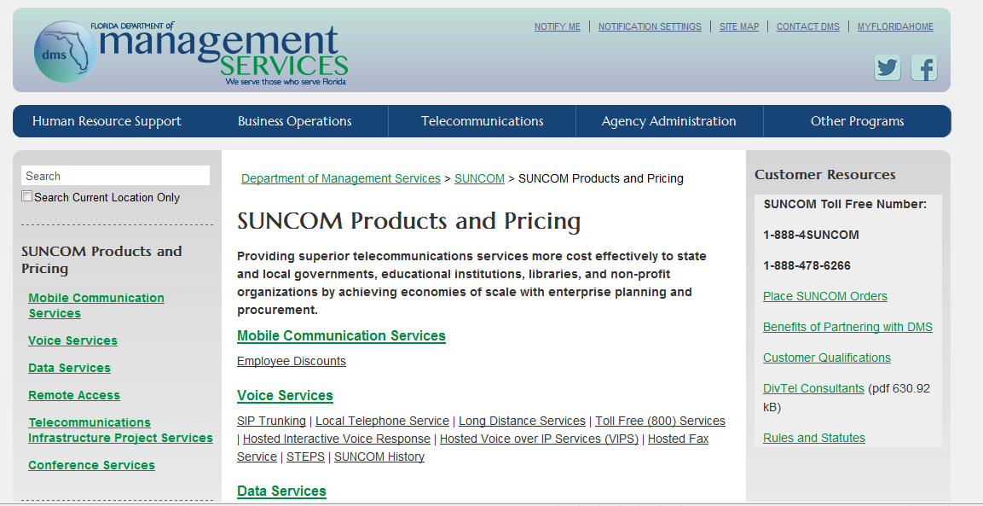
http://www.dms.myflorida.com/suncom/suncom_products_and_pricing

Slide 3
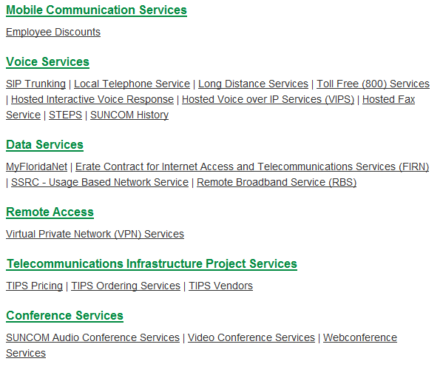
SUNCOM Products and Pricing
http://www.dms.myflorida.com/suncom/suncom_products_and_pricing

Slide 5
Items to Move
Furniture
Files
Office Contents
Copiers
Computers
Personal Belongings
Telephones

Slide 6
Services to Move
Phone System
Telephone Lines
Fax Lines
Agency Data Network and Internet Access

Slide 7
Services to Move cont.
Phone System
  Who Maintains Telephone System
Telephone Lines
  Notify IT Network Section or issue CSA
    www.onlinecsa.state.fl.us

Slide 8
Services to Move cont.
Fax Lines
    Notify IT Network Section or issue CSA
      www.onlinecsa.state.fl.us
  Agency Data Network and Internet Access
    Notify IT Network Section or issue CSA
      www.onlinecsa.state.fl.us

Slide 9
Preparation
Telephone Equipment Room
  Backboard
  Power
  Lighting
  Grounding
  Security
  Air Conditioning
Telephone Access Facilities
  Conduit
    Space in Conduit
    Pull String

Slide 10
Inside Wiring
Office Wiring
Cross Connects
Wall Jacks
  Are they accessible
  Are they properly located

Slide 11
Expected Intervals
Telephone Equipment Room – 30 Days
Access Facilities - 60 Days
  Unless Permits Are Required
Inside Wiring – 30 Days
Phone System – 45, 60, 90, to 120 Days
Telephone Lines (Non-Concurrent)
  PRI – 30 Days
  Centrex, Fax, and Business Lines – 2 Weeks
Telephone Company Facilities – 2 Weeks to

Slide 12
Expected Intervals continued
Data Services
  64kbps to T-1 - 25 business days
  > T1 to 45 Mbps - 40 business days
  > 45 Mbps - 90 business days

Slide 13
Assistance
Bureau of Customer Service
  Service Delivery Section
  SUNCOM NOC
  SUNCOM Business Development

Slide 14
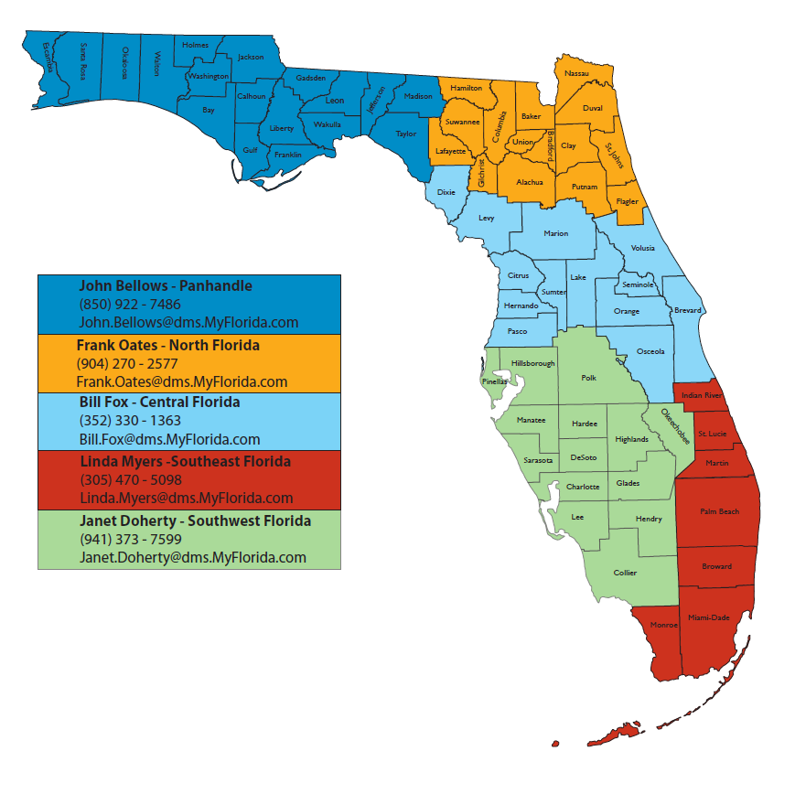
Assistance cont.

Slide 15
Assistance cont.
  1-888-4-SUNCOM (478-6266)
  SUNCOM.Helpdesk@dms.myflorida.com

Slide 16
Are you ready to move?

Slide 17
Questions?

Slide 18
Department of Management Services
Kevin Langston
Bureau Chief of Customer Service
Kevin.Langston@dms.myflorida.com

