Slide 1


MyFloridaMarketPlace
Requisitioning 101

Slide 2
Agenda
MyFloridaMarketPlace Overview
Creating Requisitions
Approving Requisitions
Change Orders
Receiving Commodities
Approving Services
Creating an Invoice
System Searches
Resources
Notes:
Today’s, agenda is on the screen.
We will go through an overview of MyFloridaMarketPlace which includes basic navigation information.
We will review some basic purchasing information and incorporate that information into creating and approving a requisition.
We will look at creating a change order on an approved order, then, how to receive commodities and approve services.
We will take a look at how to create a system search and spend some time in the training environment reviewing the information we have learned.
Finally, we will look at some resources to assist you in your journey through MyFloridaMarketPlace.
As we go through today’s session, we will use the terms MFMP and MyFloridaMarketPlace. Both terms refer to the MyFloridaMarketPlace system, and MFMP is the current system version.

Slide 3
MyFloridaMarketPlace Overview
Overview
MyFloridaMarketPlace began July 1, 2003, and is Florida’s source for centralized procurement.
Access to online catalogs and information about vendors that provide goods and services to the state.
24/7 online access to the system’s registered vendors, State Term Contracts, quoting, and sourcing.
Notes:
MyFloridaMarketPlace, also known as MFMP, is the State of Florida’s electronic procurement system, which began in July 2003.
When used completely, MyFloridaMarketPlace provides a complete audit trail from procurement to payment. It records your requisitions, purchase orders, and your receiving reports all the way to invoicing and payment. MFMP also keeps a history of all actions completed within the transaction. This allows for review of what information was changed and who initiated the change.
MyFloridaMarketPlace is an Internet-based program available 24/7. With MyFloridaMarketPlace you can access online catalogs and information about vendors and their registration.

Slide 4
MyFloridaMarketPlace Overview
Benefits of Using MyFloridaMarketPlace
Reduced Error Rates
Faster order processing time
MyFloridaMarketPlace leverages the state’s significant buying power
Notes:
MyFloridaMarketPlace reduces error rates by validating purchasing and Finance and Accounting information.
It allows for faster order processing through automating the transaction workflow and delivery to the supplier.
When agencies make all purchases through MyFloridaMarketPlace, the system captures spend data for the entire state, as a single entity.
That data is then accessible for leveraging during contract and purchasing negotiations to deliver best available pricing for all agencies.

Slide 5
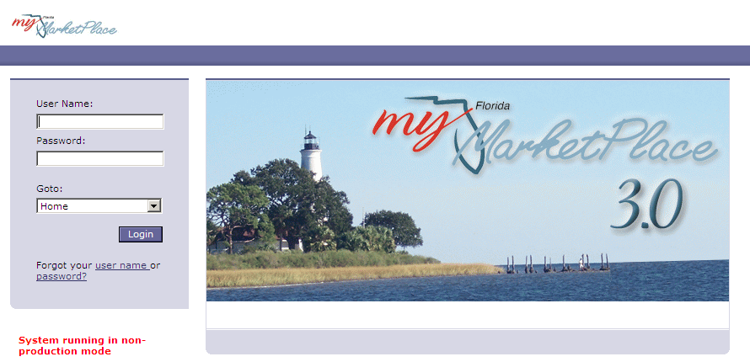
MyFloridaMarketPlace Overview
https://Buyer.MyFloridaMarketPlace.com/Buyer/Main
Notes:
This screen shows the URL for MyFloridaMarketPlace. Make sure you bookmark the link.
https://buyer.myfloridamarketplace.com/Buyer/Main

Slide 6
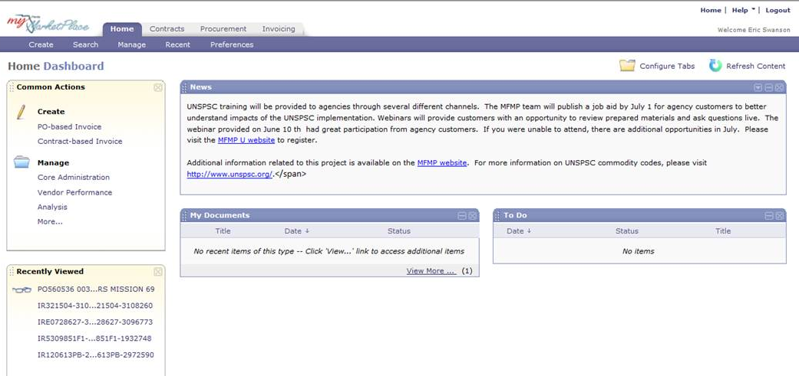
MyFloridaMarketPlace Overview
Customizable Dashboard
Notes:
When you log in to MyFloridaMarketPlace you land on the Dashboard. Using the dashboard, you create and manage your work in the Common Action and Recently Viewed section.
The Dashboard “News” section displays information similar to the information posted on our bulletin board. This information is updated regularly to inform customers of important information surrounding MFMP. This may be enhancements or training notices.
The Dashboard includes a section titled “To Do.” These are the things assigned to you that need you to take action with.
Items you create display in the “My Documents” section.
The Dashboard gives you a quick search feature allowing you to search by the specific ID number of the requisition or order. Use the Search link at the top of the Dashboard in the menu bar to conduct searches.
When you create a search enter at least three search criteria. We will talk more about searches later in the presentation.
You can minimize or maximize each of these new display queues by clicking the dash or X in the upper right corner of the queue.
To enhance your experience on the dashboard, we recommend you only display the necessary “display queues.”

Slide 7
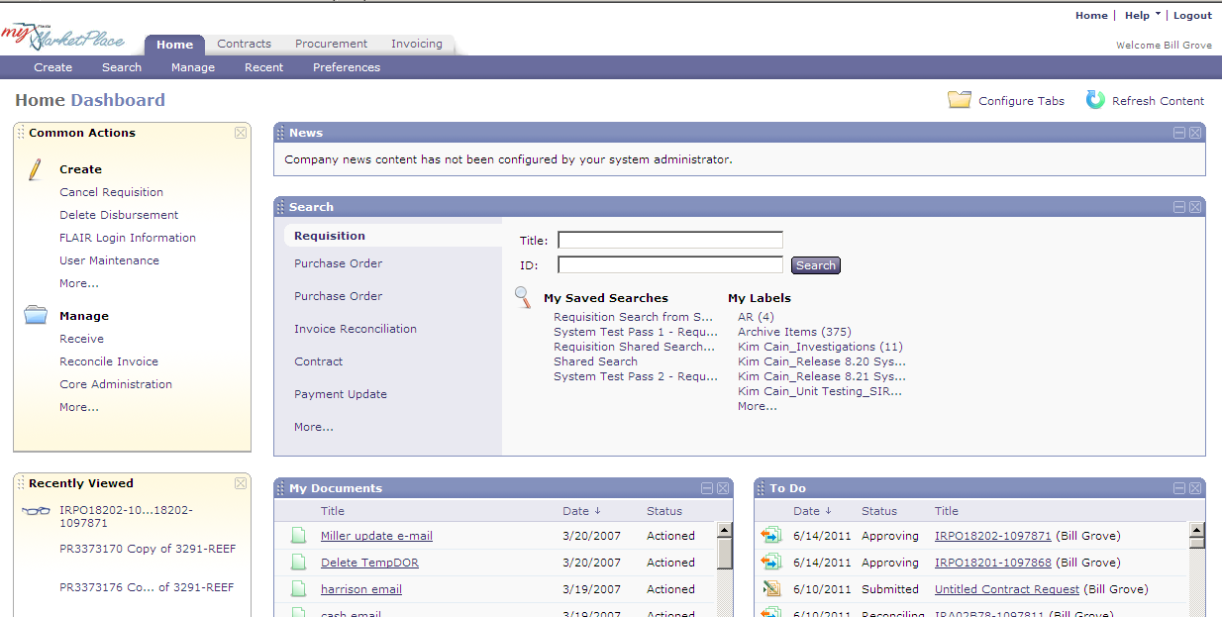
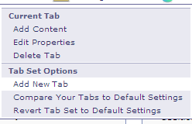
MyFloridaMarketPlace Overview
Customize Tabs on the Dashboard
Notes:
MyFloridaMarketPlace displays Dashboard tabs relevant to your groups.
You can remove the tabs you do not wish to use from your view.
To remove tabs, click on the tab you wish to remove, click "Configure Tabs." Then select Delete Tab. If you delete a tab in error, click "Configure Tabs" then select "Revert Tab Set to Default Settings"

Slide 8
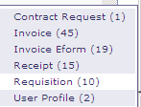
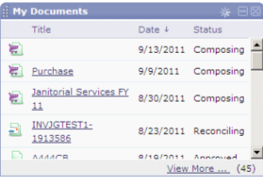
MyFloridaMarketPlace Overview
Expand the Dashboard View
Click on "View More"
Select the item to view
Notes:
If all of your documents do not display in one of your display queues, click "View More" to view the list.
A pop up window displays the types of items in the queue.

Slide 9
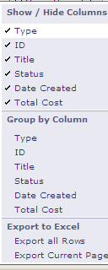
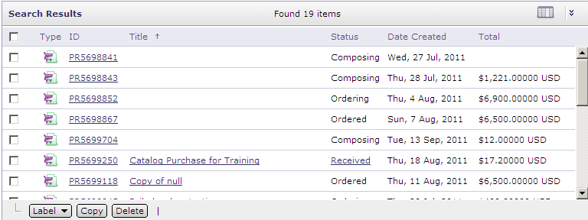
MyFloridaMarketPlace Overview
Expand the Dashboard View
Notes:
MyFloridaMarketPlace allows you to expand the Dashboard View so that you can drill down to specific types of documents.
You can also click on the Tables Options icon to select the columns that you want to have included or excluded in your view and you can also choose various ways to group the documents in the view and lastly there is an ability to export the view to Excel.

Slide 10
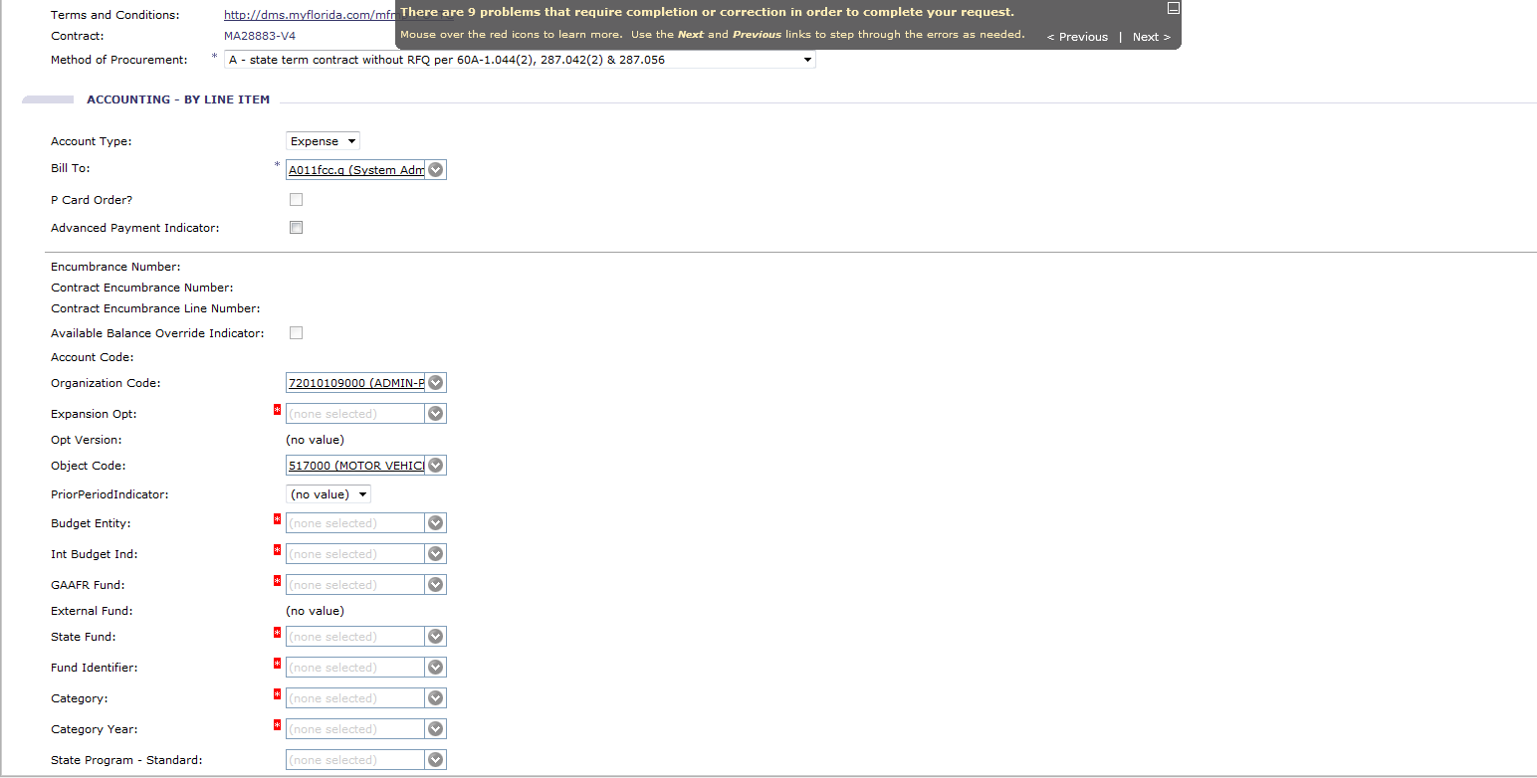
MyFloridaMarketPlace Overview
Detailed error messages include number of errors.
Notes:
If there are errors on your page, MyFloridaMarketPlace indicates at the top of the page the number of errors and where they are located.
As you see in this example we need to correct 10 problems.
The first error on the page is the blank vendor location. As you correct errors, the number indicated at the top reduces and MyFloridaMarketPlace highlights the next error on the page.

Slide 11
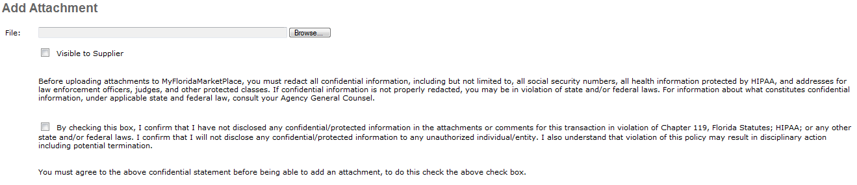
MyFloridaMarketPlace Overview
Confidential Information
MyFloridaMarketPlace prohibits customers from including in the system confidential Information directly related to an individual.
  Comments field
  Line item description
  Attachments
Attachment confirmation checkbox
Notes:
MyFloridaMarketPlace and your agency need to prevent confidential information from being entered into MyFloridaMarketPlace.
This includes information in the comments field, the line item description and the attachments.
Before you add an attachment, you have to check the confirmation box, confirming you have not disclosed any confidential information.

Slide 12
MyFloridaMarketPlace Overview
Confidential Information
The following list shows examples of common types of confidential information to redact:
    Names and Titles
    All street addresses, city, county, and zip codes
      All elements of dates (except year) directly related to an individual, including birth date, admission date, discharge date, and date of death
    Telephone numbers
    Email addresses
    Social Security numbers
    Medical record numbers
    Health plan beneficiary numbers
    Account numbers
    Certificate or license numbers
Notes:
This list is not exhaustive, but provides the common types of confidential information to redact from attachments included in MFMP.
Direct agency-specific questions your HIPAA compliance officer or General Counsel’s Office.

Slide 13
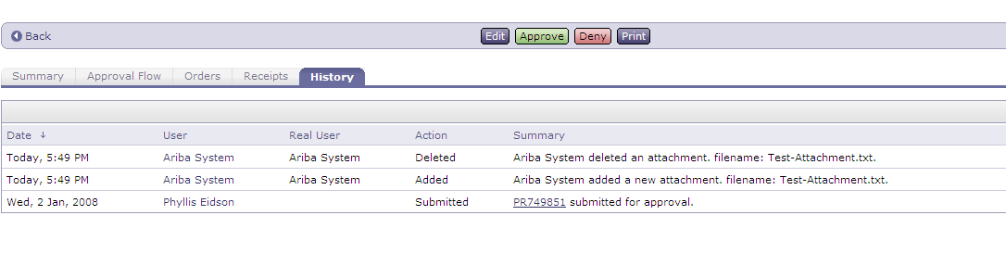
MyFloridaMarketPlace Overview
Delete Attachments and Comments
Whoever attaches the document or comments can remove them
  This applies to requisitions / orders and invoice
  reconciliations
  Remove even if the approval process already started
  Transaction workflow will not regenerate
Notes:
MyFloridaMarketPlace allows you to add and delete comments and attachments.
If you add an attachment or comment and realize either or both include confidential information, you can delete the attachment or comment.
The history tab maintains the history of when you add and delete items.
The most important thing to remember: Whomever attaches the document is the only person who can remove the document.
This applies to requisitions, orders, receipts, invoices and invoice reconciliations.
A customer can remove an attachment or comment even if the approval process has already begun. The transaction workflow will not regenerate if you remove the attachment or comment.

Slide 14
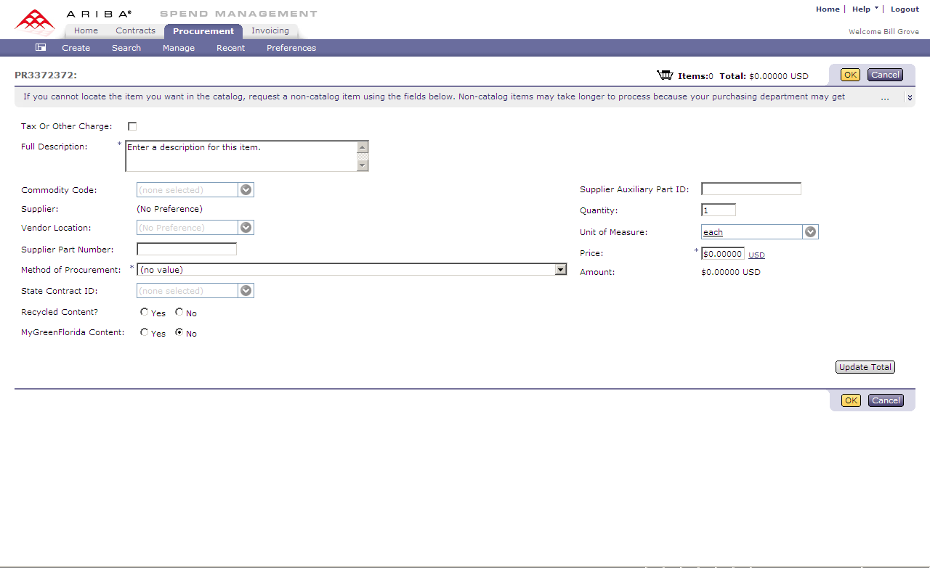
MyFloridaMarketPlace Overview
Indicate Recycled and Green items on Punch-out and Non-Catalog items
Notes:
In MyFloridaMarketPlace, customers can choose to identify Green and Recycled items by selecting the Yes radio button for non-catalog and punch-out items. MyFloridaMarketPlace populates this information for the line item catalogs available in the system.
If you are unsure if an item should be marked "Green" or "Recycled" contact your Purchasing department.

Slide 15
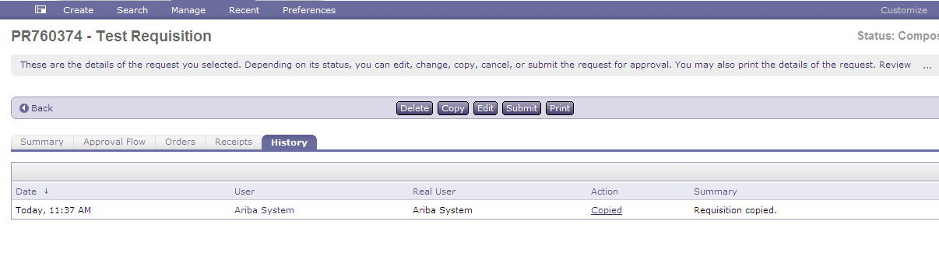
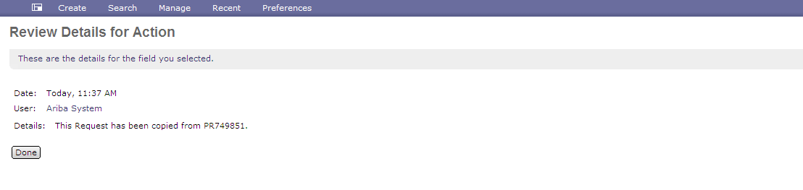
MyFloridaMarketPlace Overview
Requisitions copied display as a link in the history tab
Including the requisition it was copied from
Notes:
You can copy requisitions you previously created.
If you have the Query group, you can copy requisitions created by other customers.
When you copy a requisition, MyFloridaMarketPlace uses the history tab to maintain a history of who, by name, and the date the requisition was copied as well as recording the original requisition number you are copying from.

Slide 16
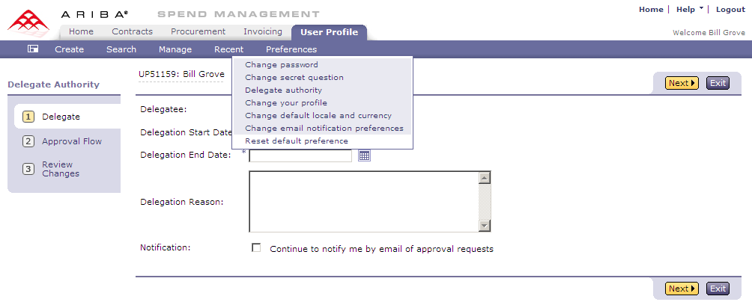
MyFloridaMarketPlace Overview
Preferences
Change your password
Delegate approval authority
Email notification preferences
Notes:
The Preferences option allows you to update information in MyFloridaMarketPlace including :
Your password, or your secret security question and answer.
your Delegation of Approval Authority when you go on leave
email notifications which allow you to adjust the number and/or frequency of the emails you receive from MFMP.
Use the preference dropdown feature on the menu bar to complete these actions.

Slide 17
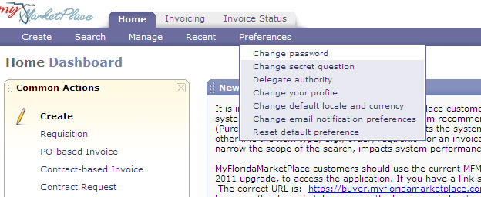
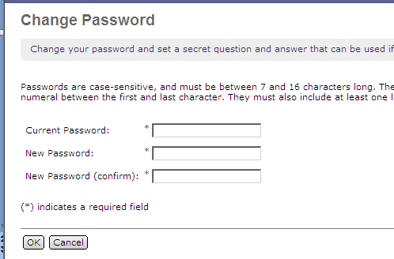
MyFloridaMarketPlace Overview
Change your password
Notes:
To change your password, select Change Password from the dropdown.
Enter your current password, enter your new password and confirm it. Click ok. You can update your password at any time.
Your password must meet the MFMP password requirements which we will discuss in the next couple of slides.

Slide 18
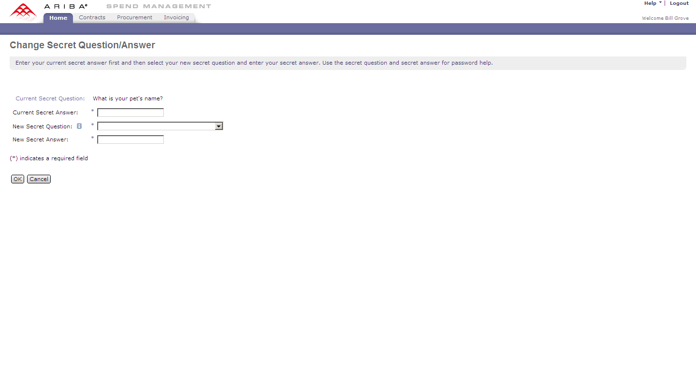
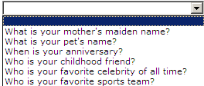
MyFloridaMarketPlace Overview
Change your Secret Question/Answer
Notes:
To change your "Secret question and answer" select it from the Preferences dropdown.
Type in your current secret question answer, then use the drop down to select your new question and type in the answer.
Please note that the answer to the secret question is case-sensitive and has to be at least five characters.
Examples of the secret questions are, what is your pet’s name or what is your mother’s maiden name?

Slide 19
MyFloridaMarketPlace Overview
MyFloridaMarketPlace Password Complexity
Passwords must comply with State of Florida security standards
7-16 characters in length with no spaces
New Password requirements include:
  One uppercase letter
  One lowercase letter
  One digit, located within the middle of the password
Unable to re-use your last five passwords
Notes:
MFMP password requirements comply with State of Florida security standards.
In MFMP all passwords expire after 90 days.
You can not reuse your last 5 passwords.
Your passwords must be between 7 and 16 characters long with no spaces.
- Passwords need to include:
- One uppercase letter
- One lowercase letter and
One digit – you must locate a single digit within the middle of the password. For example: Password2
and 2Password are invalid; however, Password22 and Pass2word are both valid.
An example of a password that will meet the criteria and be more memorable is to use your favorite password with some modifications.
MFMP passwords expire every 90 days, or quarterly. An example would be: q3Password12015
Where Password1 represents your favorite password.

Slide 20
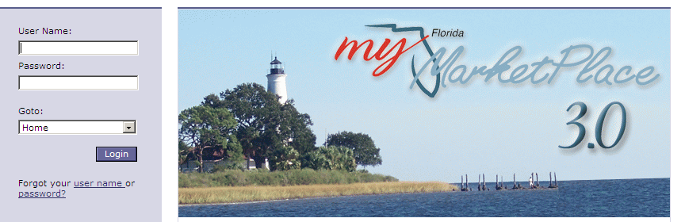
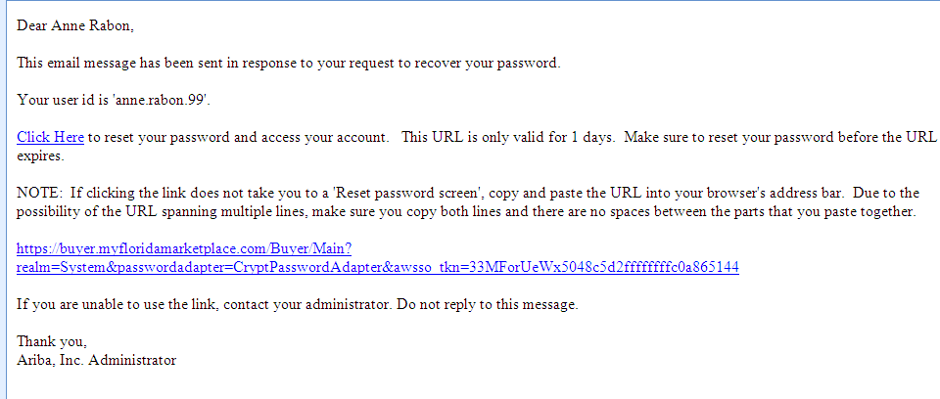
MyFloridaMarketPlace Overview
Password Reset
Notes:
If you forget your password, click the “Forgot Password” option on the MyFloridaMarketPlace login page.
Enter your username and then answer your secret question. MyFloridaMarketPlace emails you the “Password Reset Instructions” with a personalized link that allows you to access a new screen to enter a new password.
Emails for password reset requests expires 24 hours after they initiate. Upon the creation of a new password, MFMP automatically logs you in. Once you successfully create a new password, the link in the “Password Reset Instructions” email becomes unusable.
If you enter three incorrect responses to your secret question, the password reset functionality becomes disabled for 60 minutes. If this happens, contact your agency system administrator who can reset your password. The system administrator can reset your password not the MFMP customer service desk.

Slide 21
MyFloridaMarketPlace Overview
Delegate your Approval Authority
When on leave and/or out of the office, complete a Delegation of Authority.
Delegation of Authority allows approval of requisitions, invoice reconciliations (IR) and receipts in a timely manner in your absence.
Submit your delegation in advance to obtain your supervisor’s approval before you leave.
The scheduled delegation begins at 12 a.m., Eastern time on the date selected and ends at 11:59 p.m. on the selected End Date.
Notes:
MyFloridaMarketPlace recommends you set your Delegation of Approval Authority when you plan to be out of the office.
Setting the Delegation of Authority allows someone to approve and receive items in your absence.
Your supervisor must approve your delegations, so be sure to set up your delegation to allow your supervisor enough time to approve it.
Delegations begin at 12 a.m. the day you select as the Begin date and end at 11:59 p.m. on the designated End Date.

Slide 22
MyFloridaMarketPlace Overview
Preferences
Click on Preferences
Select Delegate Authority
Complete as usual
Notes:
Under Preferences on the menu bar, select Delegate Authority.
Enter the name of the customer you want to delegate to, enter the start and end dates.
The Delegation Reason is not required, but it is visible to your supervisor when approving.
If you wish to continue to be notified of approvals, based on your email notifications, place a check in the box.

Slide 23
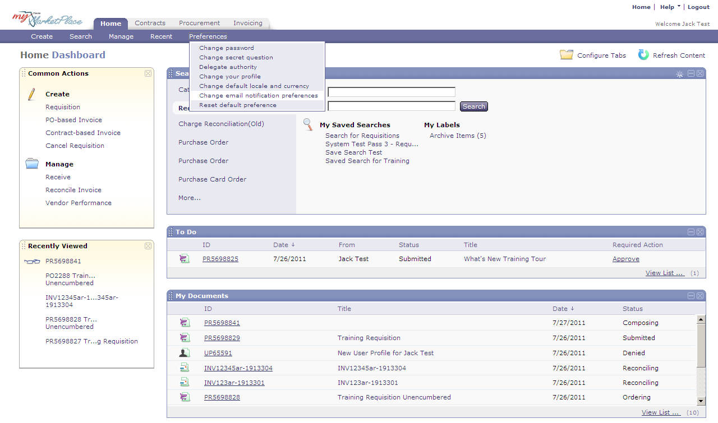
MyFloridaMarketPlace Overview
Set email Notification Preferences
Notes:
The MFMP email notification preferences settings dictate the method and frequency of emails you get from MyFloridaMarketPlace.
Select "Change email notification preference" to update these preferences.

Slide 24
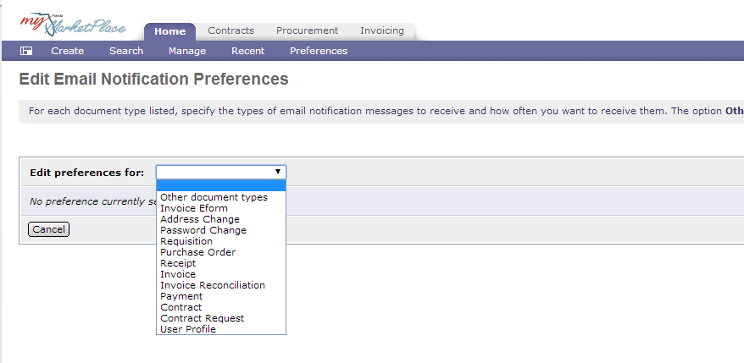
MyFloridaMarketPlace Overview
Edit Preferences
Requester | Approver | Exception Handler | Invoice Manager
Requisition | Requisition | Invoice | Invoice
Purchase Order | Purchase Order | Invoice Reconciliation | Invoice Reconciliation
Receipt | N/A | N/A | N/A
Invoice | N/A | N/A | N/A
Notes:
You can set different notification functions with different notification frequencies. Select the type of notifications you want to edit.
The table provides the recommended email preferences you may want to update based on your role in MyFloridaMarketPlace.

Slide 25
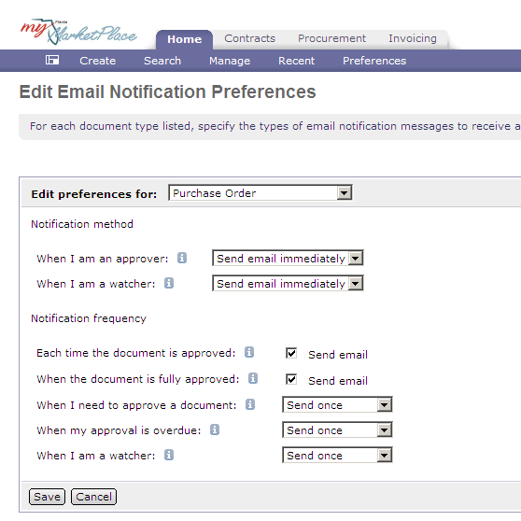
MyFloridaMarketPlace Overview
Set email Frequency
Notes:
For the notification method, indicate if you want to receive emails immediately or receive a daily summary. Complete this selection for items for which you are an approver and those for which you are a watcher. If you select Summary, you will receive an email summary every morning of all items that came to you for approval on the previous day.
Now, lets amend the frequency that you receive these emails. Do you want to receive a notification each time your document is approved or just when it is fully approved. Do you want a reminder when something is overdue? Do you want this reminder just once, or repeatedly. We recommend that you select the “never send” option only if you are in the system daily.

Slide 26
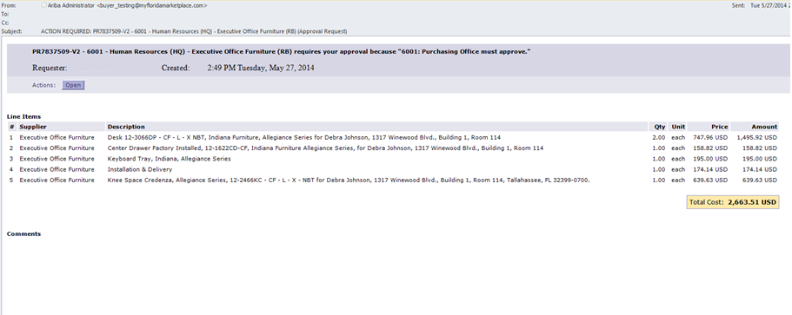
MyFloridaMarketPlace Overview
Email Notice Sample
Notes:
MyFloridaMarketPlace email notification messages are easy to read, and contain a link to the item that needs action.
This screen displays a sample email generated by MFMP. Customers, such as Approvers, who may not log in to MFMP frequently, will find these messages informative.
From this email, click Open to enter your username and password on the login screen. Then you will be automatically connected with the item you need to approve or take action on.

Slide 27
Agenda
MyFloridaMarketPlace Overview
Creating Requisitions
Approving Requisitions
Change Orders
Receiving Commodities
Approving Services
Creating an Invoice
System Searches
Resources
Notes:
Now we will review some basic purchasing information and incorporate that information into creating requisitions.

Slide 28
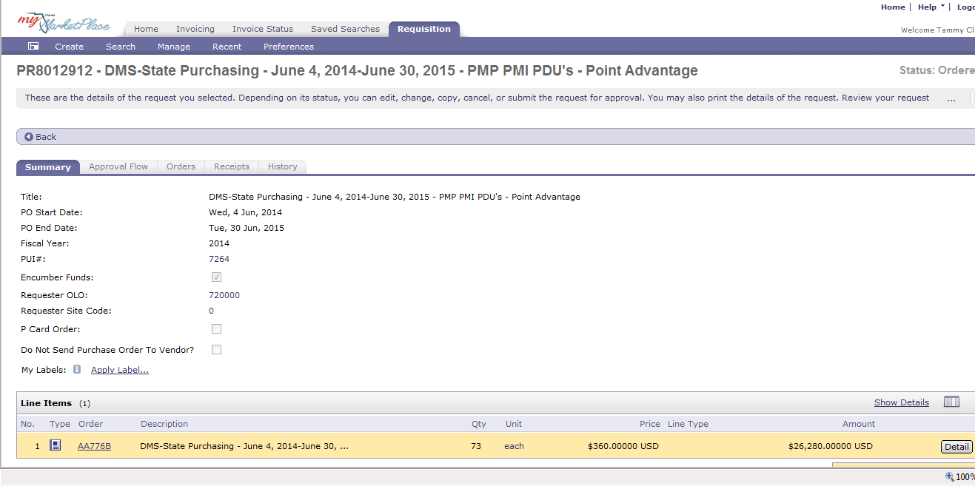
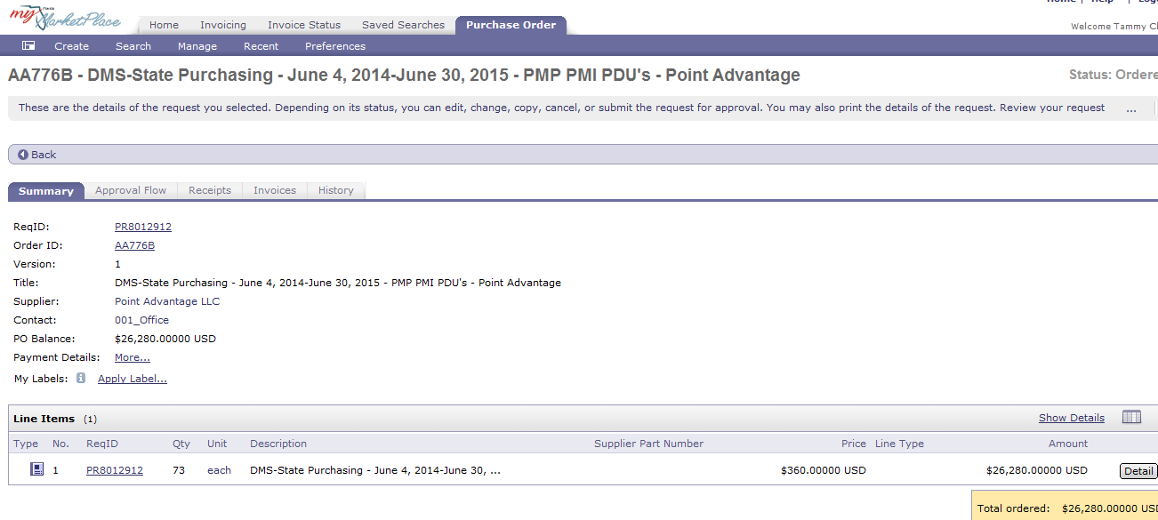
Creating Requisitions
What is a requisition?
Notes:
A requisition officially notifies purchasing offices of a need for a commodity and/or service. MFMP automates the approval process and approved requisitions generate purchase orders. Requisitions have approval flows based on agency Purchasing Unit Identifier (PUI), individual profiles and the amounts / items purchased.
MFMP assigns all requisitions a number. Once fully approved, MFMP assigns the requisition an order number. If you select your requisition to auto encumber through MFMP, the encumbrance number and the order number are the same.

Slide 29
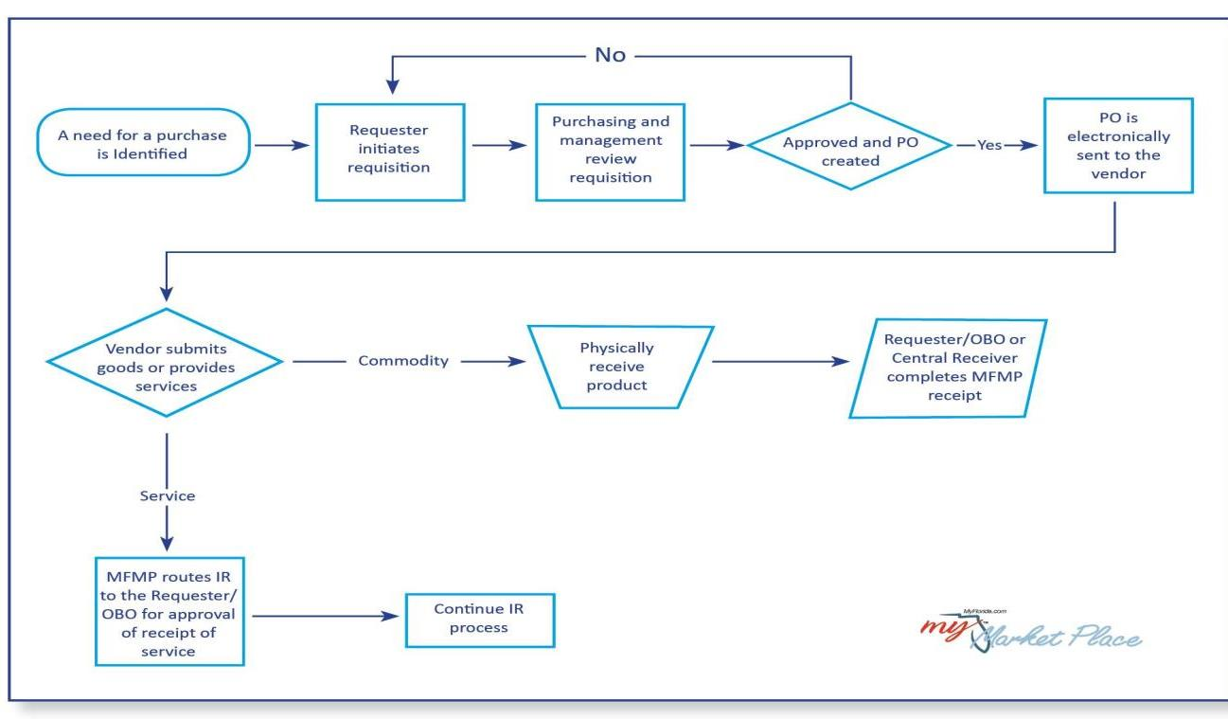
Creating Requisitions
Requisition Approval Process
Notes:
This diagram shows an overview of the process a requisition takes through the approval process in MFMP.
Someone identifies the need for a purchase and then initiates a requisition.
Management and your purchasing department review the requisition and approve or deny it based on your agency’s practices.
If anyone denies the requisition, MyFloridaMarketPlace returns it to the requester to amend or begin again.
Once management and your purchasing department approve the requisition, MyFloridaMarketPlace automatically sends the order to the vendor via the vendor’s preferred method.
The vendor fills the order and provides you with the desired commodities or services.

Slide 30
Creating Requisitions
What do the numbers with different prefixes mean?
  PR – Original purchase request number
  A – Order and encumbrance number for encumbered orders
  PO – Order number for unencumbered orders
  C – Order number for unencumbered order set up against state term contract in MFMP
  MA – Order number for unencumbered order set up against state term contract that predates Sept 2011
  RC – An automatically generated receipt that the requester, central receiver, or OBO completes when they receive the commodity on an order
  IR – Invoice Reconciliation is the approvable in MFMP where requesters validate services
Notes:
If you select your requisition to auto encumber through MFMP, the encumbrance number and the order number are the same and will be preceded by A. If you select to unencumber your order, the order number is preceded with PO. If the order is unencumbered and set up against a STC, it may be preceded with C or MA.

Slide 31
Creating Requisitions
Requisitions and Purchase Orders
Requisitions become purchase orders (PO)
  PO is a contract between the state and vendor.
  Set up PO the same way the vendor will invoice it.
  Include information to meet audit requirements.
Setting up your requisition/PO properly may prevent:
  Confusion for the vendor.
  Payment issues.
  Delayed receipt of products/services.
  Problems with change orders.
Use the unit price
Notes:
When you create a requisition in MyFloridaMarketPlace, it becomes a purchase order and the vendor receives the approved PO electronically.
Remember: The purchase order is a contract between the vendor and the State.
You need to set up your purchase order the same way the vendor will invoice it.
For example; are you purchasing 1 case of 12 widgets, or 12 individual widgets?
Include information to document the purchase such as a justification or vendor quotes.
If your purchase order is set up incorrectly, you may confuse your vendor, or create confusion with the payment. These items may even prevent you from completing a change order later.
Also, when setting up a purchase order, it’s important to always use the unit price. We will see an example of using the unit price on the next slide.

Slide 32
Creating Requisitions
Example: PO for Janitorial Services
Line Item 1: Quantity-12 Unit of Measure- Month Price-$1,000 PO TOTAL- $12,000
Correct: This set-up allows you to process payments and create change orders successfully.
Line Item 1: Quantity-1 Unit of Measure- Lot Price- $12,000 PO TOTAL-$12,000
Incorrect: This set-up allows F&A to pay for a quantity of one when the vendor will be billing on a monthly basis. This method also directs the vendor to deliver only one item.
Notes:
Let’s take a look at a best practice example for setting up a requisition.
For this example we need a requisition for janitorial services for the fiscal year.
We will make 12 payments with a fixed cost of $1,000 a month.
We will set up the requisition for a quantity of 12 and a unit price of $1,000.
This gives the requisition total of $12,000 and Finance and Accounting the ability to pay twelve invoices.
If we set up the requisition for a quantity of 1 and a unit price of $12,000, it will still give us a requisition that totals $12,000.
However, Finance and Accounting will be able to create only one invoice in MyFloridaMarketPlace.
Every subsequent invoice will Auto Reject.
Also, you will receive an error message when you try to create a change order.

Slide 33
Creating Requisitions
Blanket Purchase Orders
Blanket purchase orders, while not preferred methods of purchasing, are necessary in situations where prices are variable or unknown.
Per section 287.057, Florida Statutes, include:
  Adequate description
  Contract period
  Method of payment
Notes:
A blanket purchase order is an arrangement under which an agency buyer contracts with a vendor to provide an item, or group of items, ordered on an as-needed basis.
An agency generally uses a blanket purchase order for a fiscal year period for such items as copier supplies, maintenance or services where the actual needs are unknown although needed quickly.
You must apply all purchasing categories, thresholds, and special requirements to blanket purchase orders, just as you would to any other purchase. When setting up Blanket Purchase Orders make sure you include all the required information that Finance and Accounting needs in order to make the payments.
Information to include with your purchase order is an adequate description, the contract period and a method of payment.
Some requisitions include services and commodities. Set the PO up with one line as a blanket order, an estimated quantity at one dollar for the unit price, and one line with the known unit price and quantity.
Many times, copiers should be set up this way.
Use the known monthly cost for the service period along with the number of months to pay on one line and an estimated number of copies for overage with the known overage fee on the second line.

Slide 34
Creating Requisitions
Blanket Purchase Orders (BPO)
Create in accordance to Memorandum No. 3 (2008-09).
Issue to one vendor in which multiple purchases can be made for a specific period of time.
Must include a scope of work and a quantifiable, measurable and verifiable unit of deliverables.
Should not exceed Category Two, $35,000 without being competitively solicited.
For large Blanket Purchase Orders, create a contract in MyFloridaMarketPlace and mark it as a BPO.
Notes:
DMS Memorandum No 3 (2008-2009) provides additional information about how to set up blanket purchase orders.
When setting up your blanket order, make sure you adhere to the following guidelines and limitations:
The total amount of the blanket purchase order cannot meet or exceed the Category two threshold, $35,000 for any given period unless the bid or single-source approval has been obtained or state/agency term contract is being used.
Blanket purchase orders should not be for a period exceeding one fiscal year and not less than one quarter. Blanket purchase orders may not cross fiscal year lines. (Example: You buy a new copier in January and want to do a blanket purchase order for supplies. Issue the blanket purchase order through June 30 for the current fiscal year.)
Blanket purchase orders must contain a statement outlining the maximum dollar amount allowed per purchase and a list of personnel authorized to use the purchase order.
Use blanket purchase orders only where they are necessary, where last minute purchases are common or where you are setting up purchases for the entire fiscal year.

Slide 35
Creating Requisitions
Requester Role
  Create requisitions
  Change orders
  Complete Receipts
  Submit Invoice
  Search and copy orders
Notes:
Requesters begin the purchasing process. Requesters can create and submit requisitions. They can create change orders for their previously established orders. Requesters who have desktop receiving can complete receipts. Requesters can also search and copy orders they create.
In MFMP, everyone has the ability to create invoices against approved orders. Check with your agency to determine if you the requester is responsible for this part of the process.

Slide 36
Creating Requisitions
State Term Contracts in MyFloridaMarketPlace
State Purchasing creates statewide agreements, State Term Contracts (STC) and Alternate Contract Sources (ACS).
Use of STC are mandatory for state agencies.
STC and ACS are available in MyFloridaMarketPlace as catalogs.
Notes:
The Division of State Purchasing creates statewide contracts and agreements for use by state agencies, local governments, educational institutions, and other entities.
These agreements enable the state to pool buying power to lower total costs and reduce administrative burden while complying with Florida’s purchasing laws.
Use of State Term Contracts is mandatory for state agencies, under section 287.056 Florida Statutes. State Term Contracts are set up in MyFloridaMarketPlace as Line Item or punch-out catalogs.

Slide 37
Creating Requisitions
  Two Types of State Term Contract Catalogs
  Line Item
    Searchable line item entries, select add as line items to requisition.
  Punchout
  Agency buyer punches out directly to the supplier’s website to add items to populate requisition.
Notes:
There are two type of Catalogs available; line item and punch-out.
MFMP enters Line item catalogs by line item. You can search for these items by item description, number or by contract. When you locate the desired item, select "Add to Cart" and MyFloridaMarketPlace enters the item information into your requisition.
Punchout catalogs allow you to punchout directly to the supplier’s website. The website has Florida contract specific pricing and allows you to add items to your shopping cart giving customers an Amazon.com type shopping experience.
When you complete your shopping, checkout from the supplier website and MyFloridaMarketPlace populates items on your requisition.

Slide 38
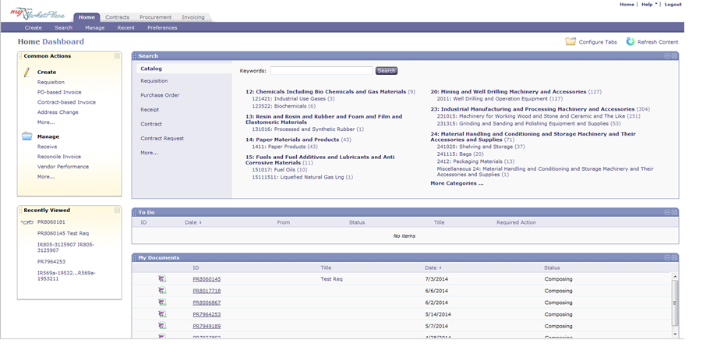
Creating Requisitions
Start Requisitions in Two Ways
Search the catalogs
Click Requisition under create in the Common Actions section
Notes:
The MyFloridaMarketPlace requisition process starts in one of two ways.
From the Dashboard, to create a requisition, you can either search the catalog or you can click on the Requisition link under Create in the Common Actions section. Either action kicks off the process.

Slide 39
Creating Requisitions
  Catalog Requisitions
  Fields that auto-populate are:
    Vendor information
    Commodity Code
    Method of Procurement
    Item description
    Item unit price
    Supplier part number
    State Term Contract number
Notes:
Create catalog orders when appropriate to comply with state law and to reduce data entry.
MyFloridaMarketPlace auto-populates several fields on a catalog requisition. These include:
Vendor Information
Commodity Code
Method of Procurement
Item Description
Item Unit Price
Supplier Part Number
State Term Contract number

Slide 40
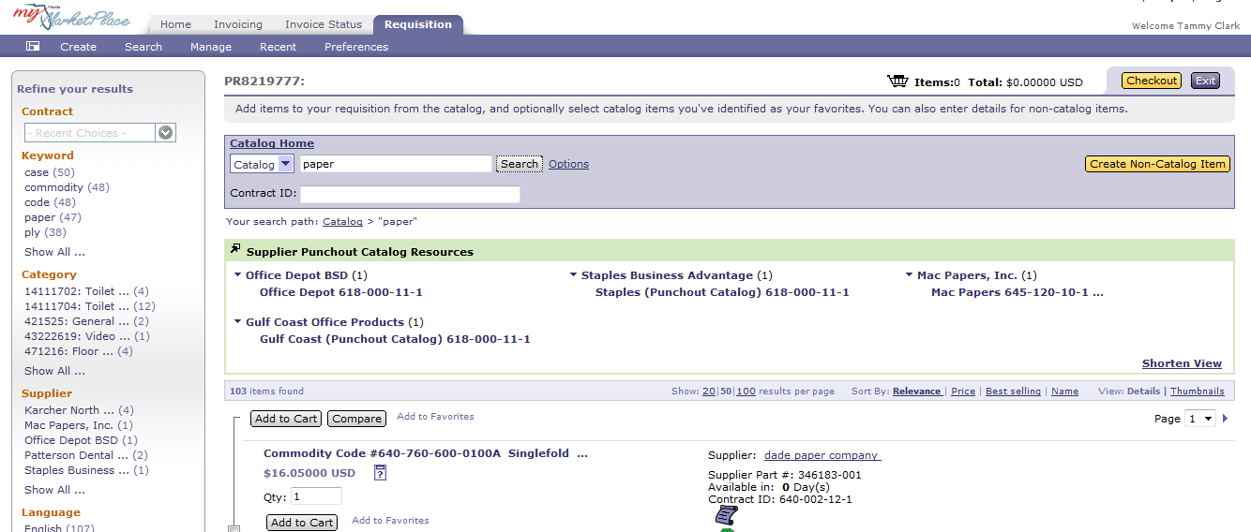
Creating Requisitions
Catalog Requisitions
Use refined catalog searches
Notes:
When you search for products in catalogs, type in keywords and refine your search using the left navigation panel.
For example, search for the word “paper.” Use the “Refine your results” box on the left of the screen to view items listed with related contracts, keywords or sold by a specific supplier.

Slide 41
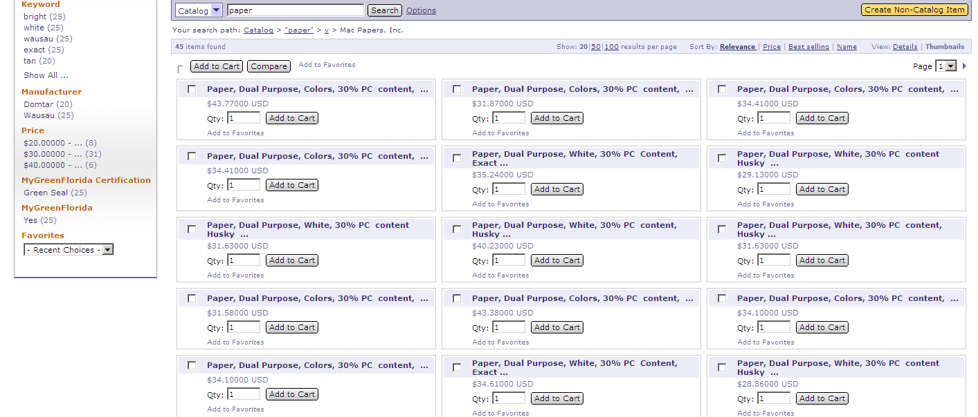
Creating Requisitions
Catalog Requisitions
Click "thumbnails" link to view multiple items at one time
Notes:
You can customize your search results view to return several items in a condensed format, by clicking on the Thumbnails link. You can also choose to sort your items by price or relevance.

Slide 42
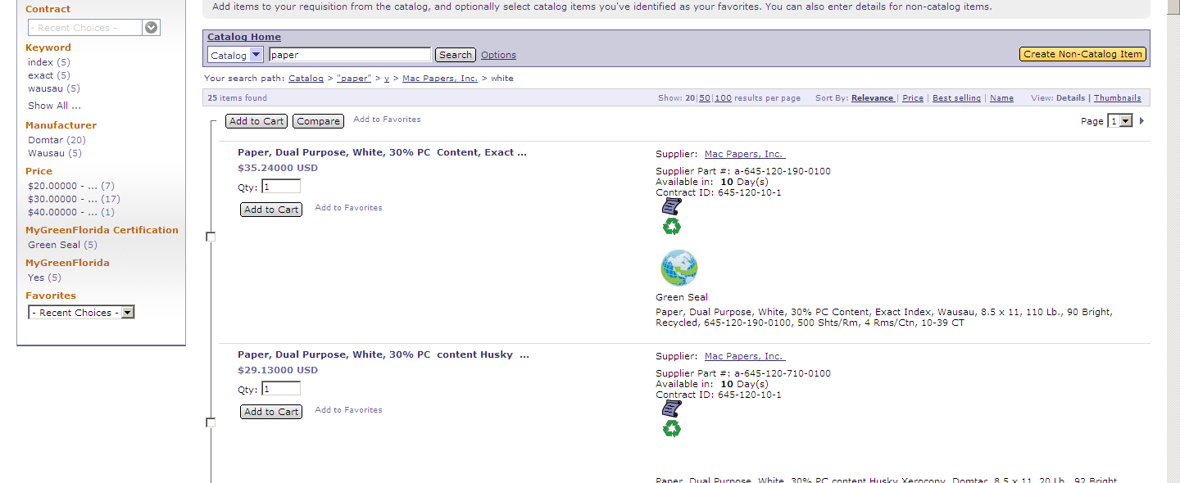
Creating Requisitions
Catalog Requisitions
Compare line item catalog products to determine the best value.
Select the items to consider and click "Compare”.
Notes:
You can compare catalog line items to help you make your purchase. Select the items you want to compare by clicking the box to the left of the item and click "Compare."

Slide 43
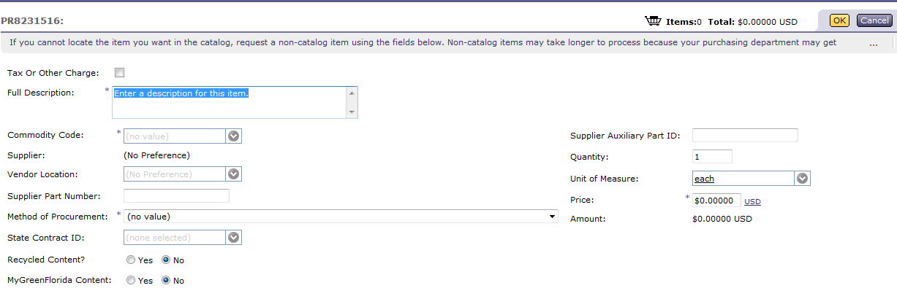
Creating Requisitions
  Non-Catalog Requisitions
  Enter a full description.
  Select the appropriate commodity code for purchase.
  Use the vendor location to select the vendor.
  Enter the supplier part number.
Notes:
If the item you are looking for is not available through one of the state term contract line item or punchout catalogs, you can create a non-catalog requisition.
Unlike the catalog requisition, no data pre-populates on a non-catalog requisition.
On the non-catalog requisition, enter a full description of the product you are ordering, including the unit price and the part number if applicable.
Select the commodity code and then select the appropriate vendor location.
Enter the appropriate method of procurement and if you use a Method of Procurement, of A, B, or C, you will be required to enter the applicable contract number. If you are using the P-Card to pay for the purchase, place a check in the P-Card box. You will have an opportunity under the Accounting Details page to enter your P-Card number and expiration date. (For Office Depot purchase marked as P-Card, you have to include your card number) Marking the requisition as a P-Card order will preclude F&A from invoicing against the approved order.

Slide 44
Creating Requisitions
Non-Catalog Requisitions
Method of Procurement.
Management, directors and State Purchasing use the information in the MOP field for spend analysis.
For MOP of A, B, or C, enter the state term contract number.
MOP B, F and 16 should be associated with an eQuote event.
Review the Appendix in the MFMP Manual for a full list of the Method of Procurements.
Notes:
The Method of Procurement is used by management, directors and state purchasing to analyze a department or the entire state’s spend by a particular vendor or for selected commodities.
The Method of Procurement identifies the purchasing method approved for the particular purchase. If you use a Method of Procurement A, B, or C, MFMP requires you to enter the state term contract number.
MOP B, F, or 16, representing informal quotes, should be associated by an eQuote to qualify for the Utilization Metric. For more information about eQuotes, see the MFMP U eQuote Job Aids, register for an eQuote training session or the online recorded training, coming soon.
For a list of the Method of Procurements available for state agencies, please see the list in the Appendix of the MFMP Manual.

Slide 45
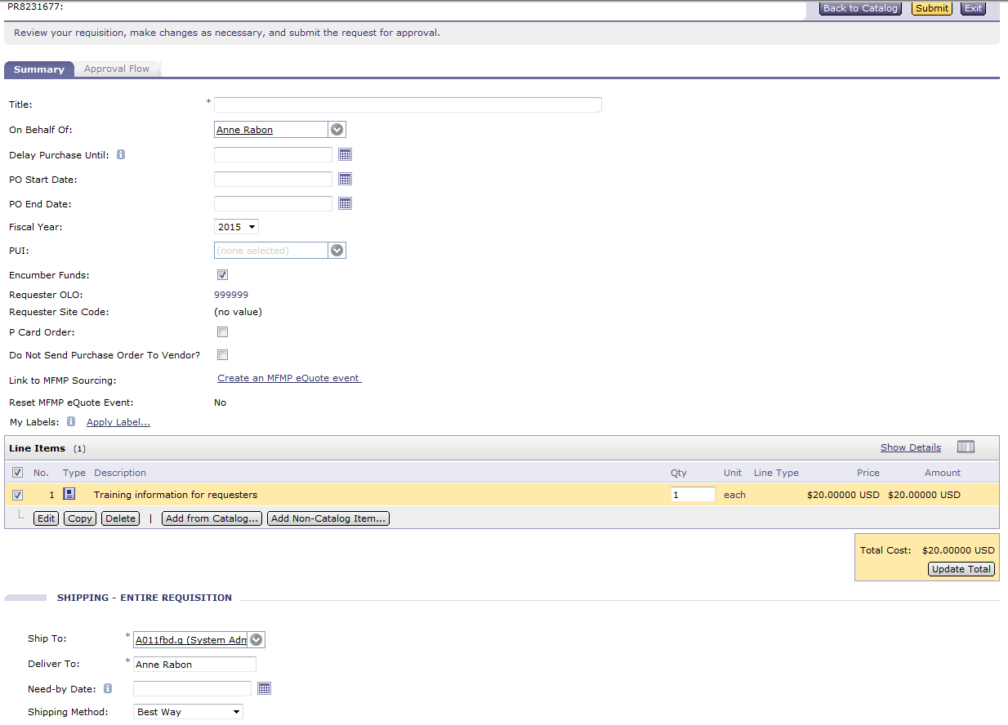
Creating Requisitions
  Requisition Summary
  The summary or review for catalog and non-catalog requisitions is the same.
  Check the P-Card box if using the P-Card for payment.
  Check the header box to mass edit all lines at once or edit individual lines.
  Review and update:
    Organization code (Org code)
    Expansion option (EO)
    Object code
Notes:
When you are through adding lines or products/services to your requisition, click Summary. The summary or review process is the same for catalog and non-catalog requisitions.
You need to add a title, review the PO start and end date and update your accounting information. The end date should be the end of the contract period or enough time for F&A to process payment. A safe date is the last date of the fiscal year the order is for.
You can check the line items header box to mass edit all lines or edit them one at a time.
Mass editing allows you to update all lines of the requisition with the same accounting information.
Update the Organizational Code, update the expansion option by selecting "search for more" in the dropdown menu.
Search for and select the EO and current version. Unless otherwise instructed by your agency, select the latest version. For example; EO K1, Version 02, not version 01.
Remember, the commodity code selected populates the object code. Double check the object code to ensure it is appropriate for your purchase.
If you receive an error “Category is required”, check with your F&A or Budget team as there may be a problem with the EO/Object Code combination you selected.

Slide 46
Creating Requisitions
  Requisition Summary
  Review the "Ship To" address.
  Enter a "Deliver To" name.
  MyFloridaMarketPlace marks comments and attachments to be invisible to the vendor.
    Check this box if you want comments to be visible to the vendor.
  Add attachments one at a time.
    Florida’s broad public records laws mean everything entered in MyFloridaMarketPlace may be subject to public view.
Notes:
Continue the review with the "Ship To" information.
The "Ship To" information defaults to the information set up in your MyFloridaMarketPlace customer profile.
Change it if you want the order shipped to a location other than your default location.
Enter a "Deliver To" name.
This field is free text so the customer listed here does not need to have access to MyFloridaMarketPlace.
Attach documents as required to process the requisition.
Before attaching a document, check the certification box, certifying that there is no confidential information attached.
Attachments and comments are not visible to the supplier by default.
Check the "Visible to Supplier" box if you want the supplier to see the comments or the attachments.
Review your requisition for accuracy and submit it.
Tip: Attachments and comments are separate in MFMP. You can keep a comment internal and/or make the attachment visible to the supplier.

Slide 47
Agenda
MyFloridaMarketPlace Overview
Creating Requisitions
Approving Requisitions
Change Orders
Receiving Commodities
Approving Services
Creating an Invoice
System Searches
Demonstration
Resources
Notes:
Let’s take a look at an approvers process for approving the requisition.

Slide 48
Approving Requisitions
MyFloridaMarketPlace Requisition Approvers
Review for:
  Management purposes
  Budgetary reasons
  Based on the "type" of request submitted
    Information Technology
    Operating Capital Outlay
    Legal Counsel
    Telecommunications
Notes:
Approvers play different roles in MyFloridaMarketPlace:
Some approvers approve requisitions as supervisors
others for budget authority
others make sure the item is consistent with your agency’s IT setup or act as other special approvers
Supervisors generate in an approval flow based on the requester’s user profile.
Other approvers are most likely part of your system-generated flow, also known as your workflow but others populate based on the commodity code and/or object code selected in the requisition.

Slide 49
Approving Requisitions
MyFloridaMarketPlace Requisition Approvers
Review that the request is necessary and appropriate.
Review should include:
  Justification
  Commodity Code and Object Code
  Method of Procurement
  State Term Contract number
  Attachments and Comments
Notes:
When reviewing a requisition, different approvers need to focus on different things. Some examples are:
Justification: Did the requester fully justify the need for the purchases?
Commodity and object codes: Are the commodity code and object code listed on the requisition appropriate for the item?
Method of procurement or MOP: Did the requester select the appropriate method of procurement?
State term contract (STC) number: Is the correct STC number selected?
Attachments and comments: Are the attachments appropriate for the purchase? Is all of the documentation to support the purchase attached. Is confidential or sensitive information included in an attachment or comment?
If you’re not sure about any of these points, you can deny the request or contact the requester for additional information.
Some approvers might also focus on the accounting details to confirm that the requester selected the appropriate codes. Remember, once approved, this requisition becomes a purchase order, a contract between the State of Florida and the vendor.

Slide 50
Approving Requisitions
MyFloridaMarketPlace Requisition Approvers
After reviewing the requisition, you can:
  Approve the requisition
  Edit and change requisition before approving it
  Deny the requisition
    Denying a requisition sends the request back to the requester
    When denying, include a comment about why you denied the request
Notes:
After you review the requisition, you have several choices: if you agree that everything looks good and is ready to proceed to the next approver
Approve the request.
If you believe an item needs to be changed you can edit the requisition and then Approve the request.
If you feel that the requester needs to make changes prior to the request moving forward or if you think this is not a justifiable purchase, Deny the request.
If the requester resubmits a requisition that was previously denied, the PR goes through the original approval process.
For step-by-step instructions, refer to the MFMP Manual on the MyFloridaMarketPlace website.

Slide 51
Agenda
MyFloridaMarketPlace Overview
Creating Requisitions
Approving Requisitions
Change Orders
Receiving Commodities
Approving Services
Creating an Invoice
System Searches
Demonstration
Resources
Notes:
Let’s talk about change orders now.
.

Slide 52
Change Orders
Changing Approved Orders
Creates a version of the requisition, represented with a V and number at the end of the requisition.
Routes through the same approval flow as the original version.
  Unless the initiator has the CO No Workflow group
Many catalog orders do not allow change orders.
  Office Depot
  Staples
  Mac Paper
Notes:
Change orders are changes to approved orders. You create a change by modifying the requisition. Changes to a requisition creates a new version identified with the letter V and the version number at the end of the requisition number.
MyFloridaMarketPlace routes change orders through the same approval flow as the original version unless the initiator has the CO No Workflow group and makes changes within this group’s parameters.
Many of the catalog vendors do not accept change orders as the process is automated, not allowing time to change the order.

Slide 53
Change Orders
What to Change
You can change most information with the exception of the vendor.
Comments are a good business practice.
You may not be able to view a change button on the requisition if:
  An IR is pending FLAIR integration; or
  A change order has already been initiated on that order and is in Composing or Submitted status
Notes:
You can change most information with the exception of the vendor or the vendor location.
Comments are not required the system, but are a good business practice and may be required by your agency. Check with purchasing for clarification.
You may not be able to view a change button on the requisition if:
An IR is pending FLAIR integration or a change order has already been initiated on that order and is in Composing or Submitted status.
You can reduce a change order only up to the amount already received or paid.

Slide 54
Change Orders
Why Change Orders Fail FLAIR
Password not on file.
Payments made directly in FLAIR.
Encumbrance not on file.
Invalid Object Code Category combination
Notes:
A change order may fail FLAIR if the Access Controller does not update the MyFloridaMarketPlace and FLAIR password according to the FLAIR password reset schedule.
If your agency processes payments directly in FLAIR, it could cause your change order to fail or become out of sync, meaning to much money may be applied back to the encumbrance.
You may get an error message that states “Encumbrance not on file” if the previous payment had the “Final Payment Indicator” selected or if the encumbrance was paid out directly in FLAIR.
Error message “Invalid Object Code Category combination” means that the EO and object code set up in the requisition is not a valid combination for the organizational code in FLAIR.

Slide 55
Agenda
MyFloridaMarketPlace Overview
Creating Requisitions
Approving Requisitions
Change Orders
Receiving Commodities
Approving Services
Creating an Invoice
System Searches
Demonstration
Resources
Notes:
Let’s talk about the receiving commodities process.

Slide 56
Receiving Commodities
Receiving is the process an agency uses to record the delivery of goods and/or services
Section 215.422, Florida Statutes, requires that agencies inspect and approve goods and/or services within five calendar days of the physical receipt.
Commodity purchase orders generate receipts in MyFloridaMarketPlace.
Two types of product receiving:
  Desktop: requester completes receipt
  Central: more than one team member receives for an entire office or group of offices
Notes:
Receiving is the process that agencies use to record when they receive goods and services.
The receipt process informs Finance and Accounting offices they can process the payment for the product.
Section 215.422 Florida Statutes, requires that agencies inspect and approve goods and/or services within five calendar days of the physical receipt.
When your purchase order moves to "ordered" status, MyFloridaMarketPlace automatically creates a receipt and places it in "composing" status for all product (or non-service based) requisitions.
Depending on your agency, you may be a desktop or a central receiver.
Desktop receiving means the requester of a requisition is required to complete a receipt.
Central receiving means more than one team member is responsible for an entire office or group of offices.
You complete the receipt in MyFloridaMarketPlace to receive commodities.

Slide 57
Receiving Commodities
Receipt facts:
MFMP places a blank receipt in composing status when the order is approved.
Partial receipt of product or service causes the receipt to remain open until Requester or Central Receiver:
  Receives order in full
  Selects the "Close Receipt" radio button
When a partial receipt is completed a new receipt is placed in "Composing" status
When you complete a receipt the order reflects a status of Receiving in the system
Notes:
A few facts to remember about the MyFloridaMarketPlace Receipt are:
A receipt is placed in composing status when a requisition moves to Ordered status and MyFloridaMarketPlace creates an order.
If you partially receive an order, only receiving 5 of 10 items ordered, MyFloridaMarketPlace places a new receipt in composing status. This process continues until all you receive all items or until you select the "Close Receipt" radio button.
When you begin to receive the order, the order reflects a status of Receiving.

Slide 58
Receiving Commodities
Services Require Approval
MyFloridaMarketPlace routes the IR to the requester or On Behalf Of for requisitions with service commodity codes.
Customer approves the IR to show that the agency received services.
  Finance and Accounting staff can process the invoice for payment
Notes:
In the MyFloridaMarketPlace Buyer application, the system will inform the user whether or not the commodity code relates to a good or service. For service orders, there is no receipt to complete on the receipt tab. When the invoice is entered into MFMP, the system routes the invoice reconciliation to the requester or the On Behalf Of for approval. This allows the requester to validate that the agency received the services. During this approval process, the requester should add any comments or attachments to the IR to facilitate payment such as the DFS required Contract Manager Statement or the Contractual Services Summary form.
MyFloridaMarketPlace then routes the invoice reconciliation to Finance and Accounting to process for payment.

Slide 59
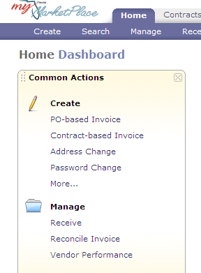
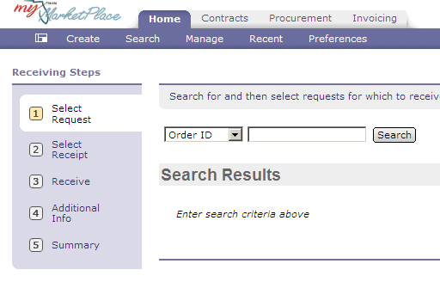
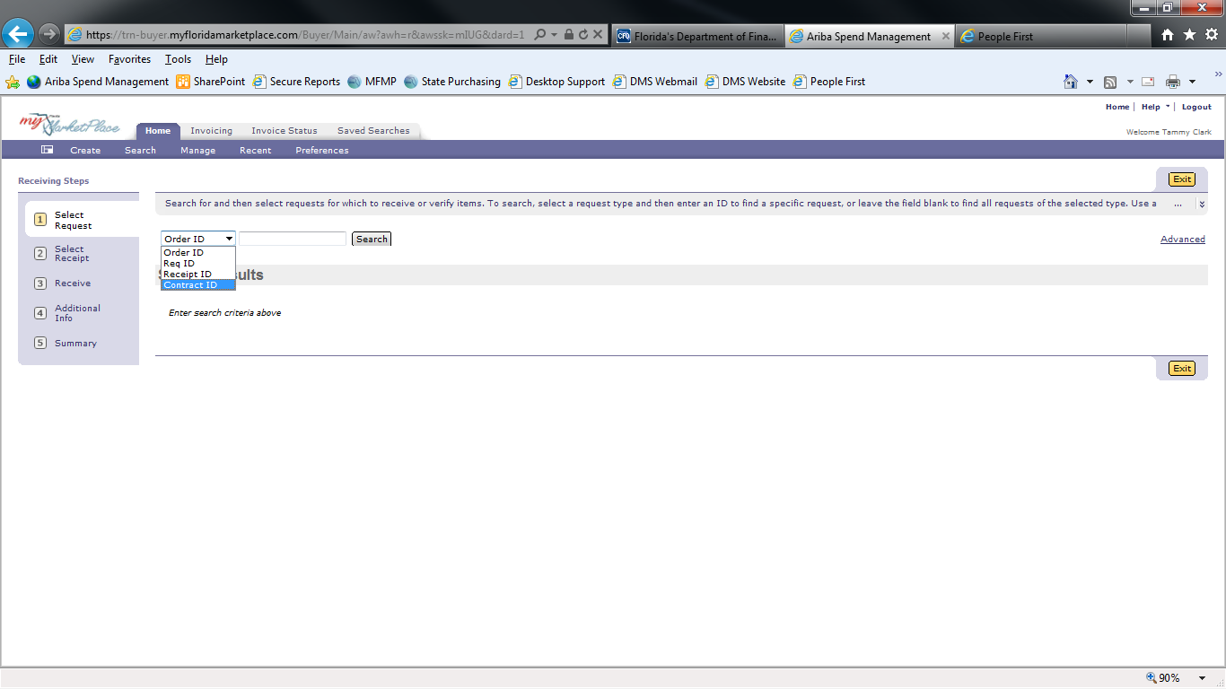
Receiving Commodities
Complete a Receipt
Click Receive under Manage on the Dashboard.
Search for the order you need to receive against.
Notes:
To complete a receipt, search for the order by clicking on Receive under Manage in the Common Actions queue. You can search by the Order ID or use the drop down, change the selection to Req ID, and search by the requisition number.

Slide 60
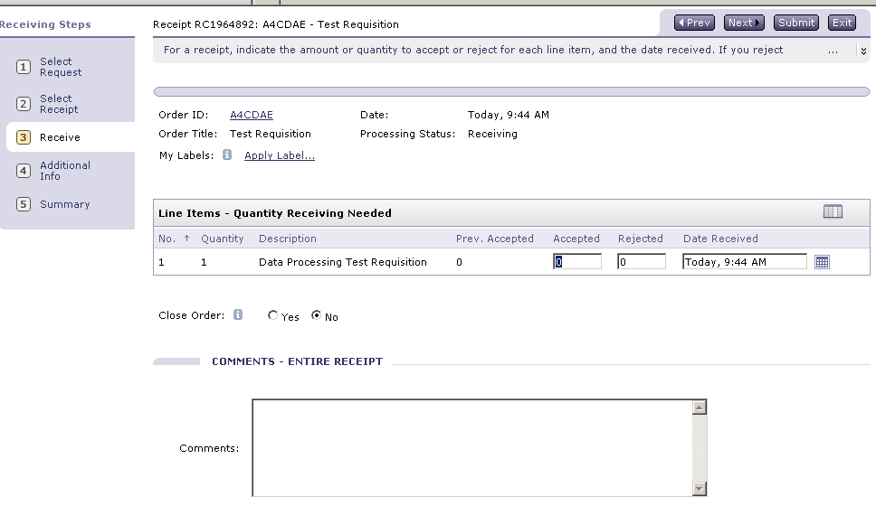
Receiving Commodities
Complete a Receipt
Enter the number of items received.
Enter the date you received them.
Notes:
When the receipt returns, enter the number of items received and the actual date you received the goods. The date defaults to today’s date, update it to the date you received the items.
If you need to correct a prior receipt, you will enter a negative receipt in the Accepted field. When making corrections, use the current date.

Slide 61
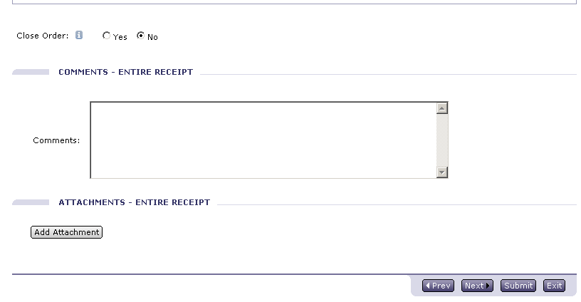
Receiving Commodities
Complete Receipt
Close Order
  Yes
  No
Comments
Notes:
Close Order defaults to No. If this receipt completes your order based on the quantity ordered and received, MyFloridaMarketPlace automatically closes the receipt for future receipts for you. This does not close the order, only the receipt.
If this receipt does not satisfy the quantity ordered, but is the last receipt you need to complete, change the radio button to yes. If the receipt is closed in error, you can reopen it for future receiveing.
Comments are not required; however, they are a good business practice such as a justification.
When you are through, click Submit. Receipts require no approval, therefore changes immediately to approved status.

Slide 62
Agenda
MyFloridaMarketPlace Overview
Creating Requisitions
Approving Requisitions
Change Orders
Receiving Commodities
Approving Services
Creating an Invoice
System Searches
Demonstration
Resources
Notes:
Let’s talk about approving services.

Slide 63
Approving Services
Approve to "receive" services
Customers approve the Invoice Reconciliation to indicate they receive services.
  This applies to all requisitions which contain a service type commodity code.
When approving services, make sure you comply to all of the DFS rules for services which includes the completion of a contractual services summary form, contract manager statement or FACTS summary form.
  For more information see
    DFS CFO Memorandum 2012-2013 01.
    http://www.myfloridacfo.com/Division/AA/Memos
Notes:
To complete a receipt for services in MyFloridaMarketPlace, approve the Invoice Reconciliation, or the IR.
When a requester or someone in Finance and Accounting creates an invoice for a requisition with a service commodity code, MyFloridaMarketPlace automatically routes the IR to the requester or the "On Behalf Of."
This approval verifies that the vendor provided the services, and the agency can process payment.
To expedite the payment process, ensure you comply with the Department of Financial Services requirements for FACTS.
CHIEF FINANCIAL OFFICER MEMORANDUM NO. 01 (2012-2013)

Slide 64
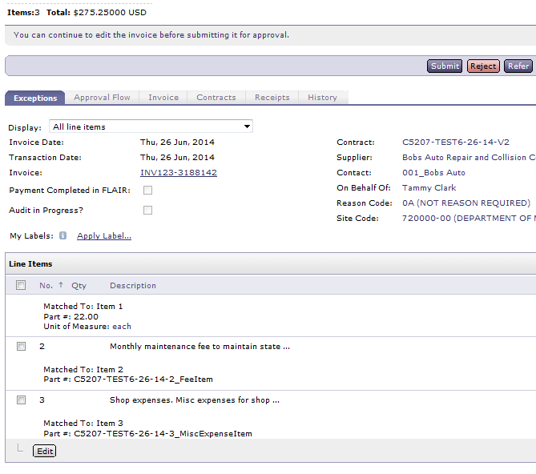
Approving Services
To Approve or "receive" Services
Click the IR link from the "To Do" queue or click on the line in your email notification.
Click Open.
Review the IR details.
Enter comments.
Enter attachments as
required.
Click Submit.
Notes:
Click on the IR from the To Do queue on your Dashboard or click on the link in your email notification to select the IR
Click Open on the IR and review the details of the order on the exceptions tab. From this tab you can review the vendor’s invoice by clicking on the invoice link or by clicking on the Invoice Tab. The scanned copy of the vendor’s invoice is at the bottom. After reviewing the vendor’s invoice, click back.
When you click Submit, you are agreeing that the services noted on the IR did indeed take place.
Enter your comments and/or attachments regarding the services and click Submit to complete the receipt.

Slide 65
Agenda
MyFloridaMarketPlace Overview
Creating Requisitions
Approving Requisitions
Change Orders
Receiving Commodities
Approving Services
Creating an Invoice
System Searches
Demonstration
Resources
Notes:
Let’s talk about change orders now.
.

Slide 66
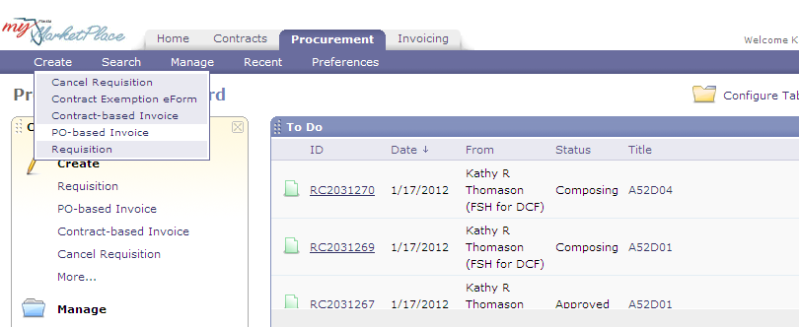
Creating an Invoice
Create PO-Based Invoice
Click on PO-based Invoice
Notes:
Entering the vendor invoice into MFMP is the way to begin the vendor payment process. Some agency requesters enter the invoice. In other agencies, this is completed by the F&A staff.
Information you will need to complete the invoice in the system is the vendor ID or name, PO number and information from the vendors paper invoice.
To complete a PO-based invoice, select "PO-based invoice" from "Create" on the menu bar or click "PO-based Invoice” under Create in the Common Actions queue.
This is where you duplicate the paper invoice the vendor submits.

Slide 67
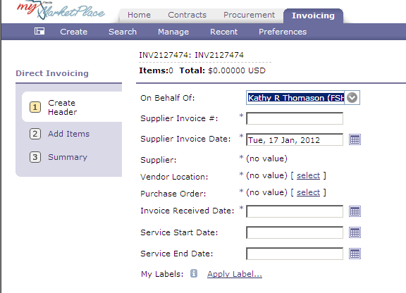
Creating an Invoice
PO-based invoice – create header
Enter Invoice Number and Date.
Select Vendor Location and PO number.
Enter Invoice received date, and service start and end dates.
Notes:
MyFloridaMarketPlace opens the invoice on the Header page. Enter the information from the paper invoice into the required fields in MFMP. Enter the invoice number, MyFloridaMarketPlace allows up to 32 characters for the invoice; however, FLAIR only records only the last nine. You should enter the vendors invoice number exactly as it appears on the paper unless otherwise instructed.
Enter the invoice date, this field defaults to today’s date, edit it to reflect the date of the vendors invoice. Select your vendor location by using the vendor name or FEIN. This information must match the information selected on the requisition. Next, select the purchase order number.
If you enter a purchase order number that you know is valid, but it returns "No results found", check the requisition to validate the vendors federal identification and sequence number. (To exit the PO Based invoice, click on summary then click exit and save changes. MFMP saves this PO Based invoice in your “My Documents” queue in composing status.)
Finally, complete the invoice with the invoice received date, service start and end dates.
The Department of Financial Services requires you to populate the service start and end date field for the invoice period of the service.

Slide 68
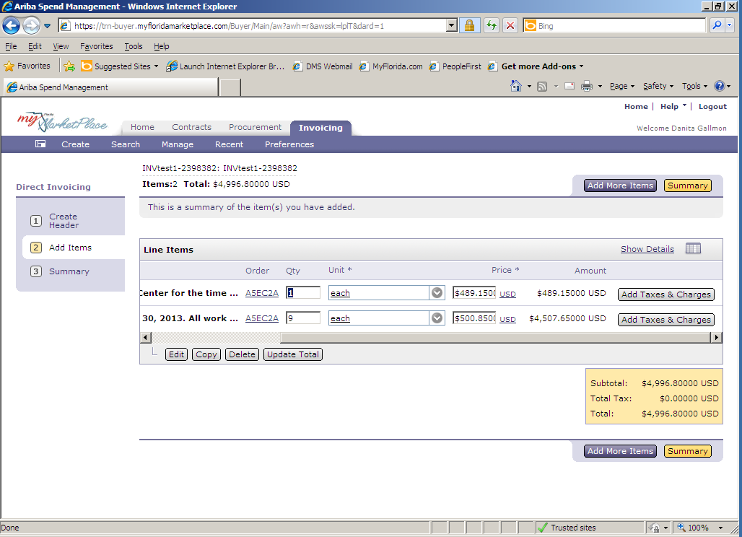
Creating an Invoice
PO-based invoice – add items
MyFloridaMarketPlace automatically generates invoice lines when you select "Next“.
Notes:
When you select next, MyFloridaMarketPlace advances to the "Add Items" page.
This action automatically populates the lines from the purchase order selected on the Create Header page.
If you need to add additional items such as shipping or tax, check with your Finance and Accounting and/or Purchasing department.

Slide 69
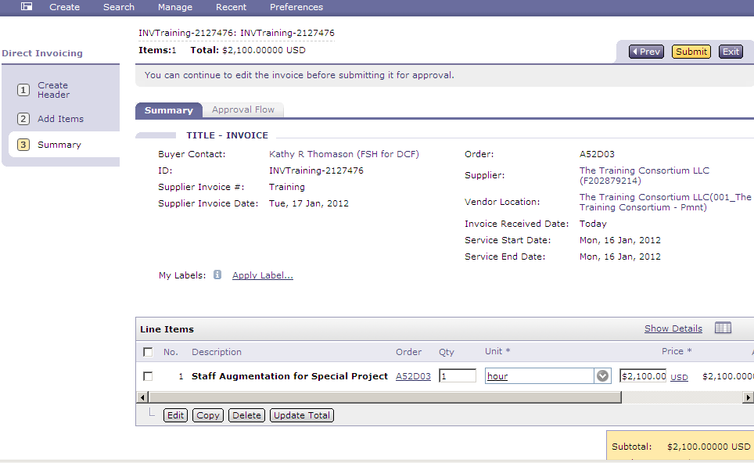

Creating an Invoice
PO-based invoice summary:
Review the invoice
Enter comments
Add attachments
Notes:
The next step is the Summary page. The Summary page allows you to review your invoice for accuracy.
Make sure the entered information matches the vendor’s paper invoice, the quantity, the unit price and the total price. Add comments for justification or to facilitate the payment process.
Department of Financial Services requires a copy of the paper invoice. Scroll to the bottom of the summary page and attach the scanned copy of your invoice.
Click Submit. Once you click Submit, you are unable to amend the PO-based invoice.

Slide 70
Agenda
MyFloridaMarketPlace Overview
Creating Requisitions
Approving Requisitions
Change Orders
Receiving Commodities
Approving Services
Creating an Invoice
System Searches
Demonstration
Resources
Notes:
Let’s talk about change orders now.
.

Slide 71
System Searches
System searches are easy to create.
Any customer with MyFloridaMarketPlace access can create system searches.
Query group enables you to see transactions enterprise-wide.
Notes:
System searches allow customers to run simple reports or locate data. System searches are easy to create. All customers have the ability to search for their own transactions and if you have the Query group, you have the ability to search all system transactions.

Slide 72
System Searches
Use a minimum of three search filters.
  Date range (Defaults to last three months)
  PUI
  Other
Save System Searches you use frequently.
Export search results to Excel.
Notes:
MFMP recommends you use a minimum of three search filters to get the best results such as the date range, your PUI, or purchasing unit identifier and your specific data field.
You will notice that the Date range defaults to the last three months.
If you do not find your item within that time frame, change the beginning date to go back a year or use one of the other custom date options.
For example, you can use a custom date to display items for this year for the date, PUI7200, and the item you are looking for such as an order, requisition or a receipt.
You can save frequently used searches. Saving searches saves you time by predefining the parameters of your search.
You can even create a new tab for the saved searches that you run often. We will review this process in the next couple of slides.
To save the data from your search, export the search results to Microsoft Excel. MyFloridaMarketPlace exports a maximum of 750 records at a time.

Slide 73
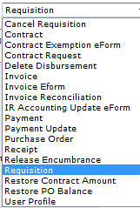
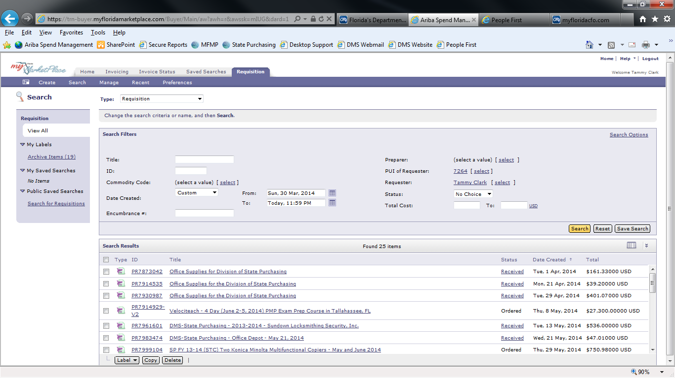
System Searches
Search Results
Notes:
Click "Search" on the menu bar. From the dropdown, select the type of search you want to complete. You can amend this selection at a later time if you like.
If you are creating a new search enter at least three custom search filters. You can change your search type based on the information you need. The search types shown vary based on your MyFloridaMarketPlace profile.

Slide 74
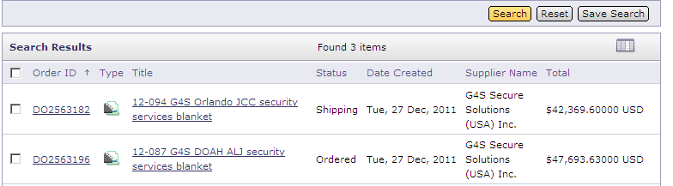
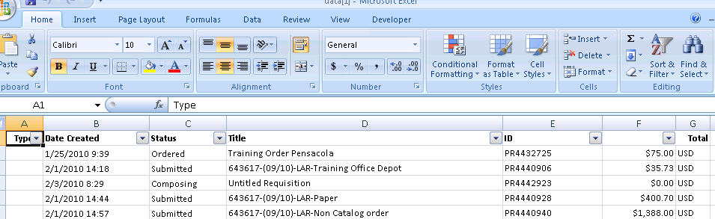
System Searches
Export System Search results
Notes:
If you want to export your System Search results, click on the "Table Options" menu and select the Export to Excel feature, Export all Rows. This exports to Excel and you can manipulate the data for further analysis.

Slide 75
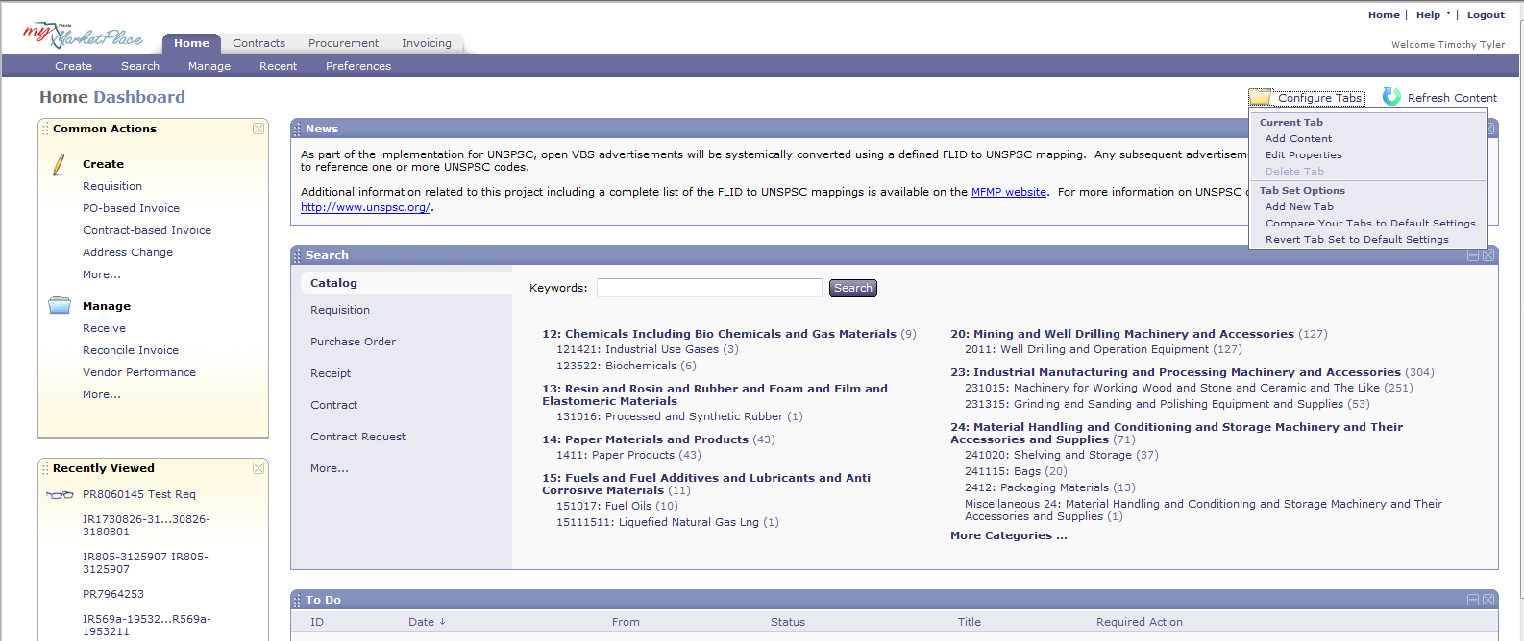
System Searches
Add new tabs to your Dashboard
Step 1
  Click "Configure Tabs"
  Select "Add New Tab"
Notes:
Not only can you save your frequently used searches, you can add them to a new tab on your dashboard to view the results quickly.
Be sure the report you add here has a minimum of three search criteria selected to maximize the results.
Add a new tab and a saved search to your dashboard in four easy steps.
First,
On your Dashboard, click "Configure Tabs"
Click "Add New Tab"

Slide 76
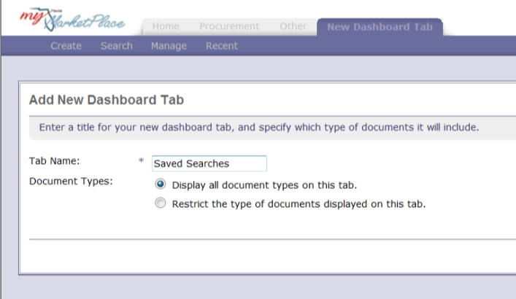

System Searches
Add new tabs to your Dashboard (continued)
Step 2
  Enter a Tab name (e.g., Saved Searches)
  Click "OK"
Step 3
  Click "Saved Search"
Notes:
Next, enter the name of your new tab, then select the radio button for Display add document types on the tab.
Click "Ok”
After adding the tab, select Saved Search from the "Add Content" box.

Slide 77

System Searches
Add new tabs to your Dashboard (continued)
Step 4
  Select "Saved Searches" you want to see on your new tab.
Notes:
You will see a list of your saved searches.
Select the appropriate "Saved Search" to add to your newly created tab.
Repeat this process to add additional saved searches to this tab.
When you are through, click done.

Slide 78

System Searches
Add new tabs to your Dashboard (continued)
Step 5
  Arrange the searches on your screen.
Notes:
The new tab, displays your saved search. Arrange the searches by dragging them and dropping them. This allows the customer to customize the view of the data.
The "Saved Search" information refreshes each time you log in and click on the new tab.
Accessing the Saved Searches from this new tab, saves you a couple of steps in the Search process. The searches are pre-populated and do not require configuration. Saved searches also gives ready access to saved searches by displaying the current results. If saving a search, you may want to use a date that always changes such as this quarter or this year.

Slide 79
Agenda
MyFloridaMarketPlace Overview
Creating Requisitions
Approving Requisitions
Change Orders
Receiving Commodities
Approving Services
Creating an Invoice
System Searches
Demonstration
Resources
Notes:
Let’s demonstrate what we learned today.

Slide 80
Agenda
MyFloridaMarketPlace Overview
Creating Requisitions
Approving Requisitions
Change Orders
Receiving Commodities
Approving Services
Creating an Invoice
System Searches
Demonstration
Resources

Slide 81
Resources
For questions or assistance, contact the MFMP customer service desk at (866) 352-3776 or BuyerHelp@MyFloridaMarketPlace.com.
Online resources at www.MyFloridaMarketPlace.com include System Administrator manuals, training information and more.
To search for vendors:
  VIP Admin: vendor.MyFloridaMarketPlace.com.
    Username and password: "publicuser"
Notes:
You can contact the MyFloridaMarketPlace customer service desk at (866) 352-3776 or at the email address noted here.
The MFMP Buyer Toolkit includes many resources, such as the MFMP Manual. The manual provides step-by-step instructions for the many processes in MyFloridaMarketPlace.
Many customers need assistance searching for vendors. Use the links listed here for MarketView and Vendor Information Portal to search vendors.

Slide 82
Resources
Register for MFMP training or access training materials with the following links:
  Registration: http://www.dms.myflorida.com/business_operations/state_purchasing/myfloridamarketplace/mfmp_university/agency_customer_training_registration
  Training Materials: http://www.dms.myflorida.com/business_operations/state_purchasing/myfloridamarketplace/mfmp_university/course_catalog/mfmp_u_training_materials
Training environments allow you to practice what you learn.
  The username is the same as your regular login.
  The password is “train30”
  Buyer Training Environment - trn-buyer.myfloridamarketplace.com/Buyer/Main
Notes:
You can register online for additional MFMP training, using the link provided here.
Access the MFMP Training Tours, recorded training sessions, through the link shown here.
The "Training Environment" is lets you practice what you learn. Your username is the same as it is in the "production" environment and the password is "train30".

