Slide 2
Table of Contents
Department of State Presentation
Leasing Reminders
How to complete a Request for Space Need
Forms/Checklists/Signature Authority
REDM Reorganization
TRIRIGA Update
Statement of Work (SOW) and Engagement Checklist
Annual Data Gathering Update
CBRE presentation – Construction Management

Slide 3
LEASING REMINDERS REQUEST FOR SPACE NEED (RSN)
Dept. of State Presentation
Leasing Reminders
REDM Reorganization
TRIRIGA Update
SOWs and Engagement Checklists
Annual Data Gathering Update
CBRE Presentation

Slide 4
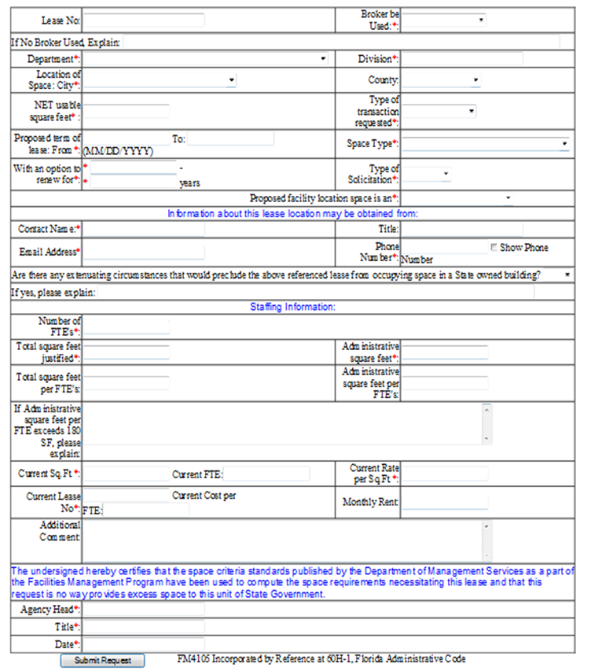
How to Complete an RSN
Dept. of State Presentation
Leasing Reminders
REDM Reorganization
TRIRIGA Update
SOWs and Engagement Checklists
Annual Data Gathering Update
CBRE Presentation
An RSN is required for each lease transaction in accordance with Section 255.25 (2), F.S.

Slide 5
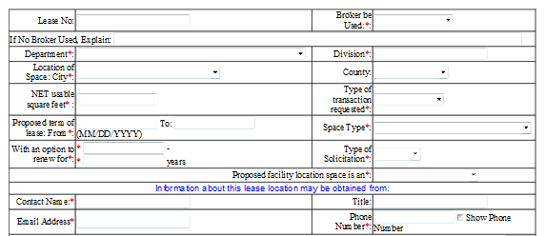
How to Complete an RSN
Dept. of State Presentation
Leasing Reminders
REDM Reorganization
TRIRIGA Update
SOWs and Engagement Checklists
Annual Data Gathering Update
CBRE Presentation
Existing Lease Number. For new leases enter your 3 digit Agency prefix and 0NEW
A broker must be selected if the SF is in excess of 2,000 SF
Drop down for transaction type –
New, Renewal, Modification….
Net Usable SF is found on the SAW in the Total Usable Area SF column
This should be the Agency contact for any questions

Slide 6
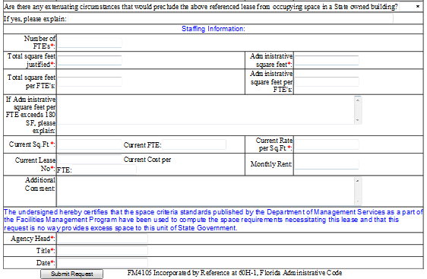
How to Complete an RSN
Dept. of State Presentation
Leasing Reminders
REDM Reorganization
TRIRIGA Update
SOWs and Engagement Checklists
Annual Data Gathering Update
CBRE Presentation
If state space is available Agency will need to review that space and the RSN will remain unapproved until it is determined if the space is acceptable.
Must enter at least 1
Total Useable Area SF from SAW
Sub-Total Usable Area SF from SAW
Must be less than 180 SF per FTE
Justification if space is over 180 SF per FTE. RSNs with SF per FTE over 180 will not be approved.
Enter detailed description of the type of transaction requested.
Authorized person listed on Agency’s authorized Signature Authority Form (FM-4106)

Slide 7
How to Complete an RSN
Dept. of State Presentation
Leasing Reminders
REDM Reorganization
TRIRIGA Update
SOWs and Engagement Checklists
Annual Data Gathering Update
CBRE Presentation
REMINDERS:
A Space Allocation Worksheet (SAW) should be submitted with each RSN for new leases or lease modifications that have a change in FTEs or square footage.
You must always enter at least one FTE in order for the form to be accepted.
SF per FTE should be 180 or less on page 1 of the SAW.
Submit boundaries for new leases.

Slide 8
LEASING REMINDERS FORMS
Dept. of State Presentation
Leasing Reminders
REDM Reorganization
TRIRIGA Update
SOWs and Engagement Checklists
Annual Data Gathering Update
CBRE Presentation

Slide 9
Forms
Dept. of State Presentation
Leasing Reminders
REDM Reorganization
TRIRIGA Update
SOWs and Engagement Checklists
Annual Data Gathering Update
CBRE Presentation
Just a reminder to pull current forms from our website before each new lease action.
The Agency Review Checklist is also routinely updated and is lease action specific.
If there are any updates to an Agency’s Authorized Signature Authority during a fiscal year a new form (FM 4106) will need to be filed with DMS. It is available on our website.

Slide 10
REDM REORGANIZATION
Dept. of State Presentation
Leasing Reminders
REDM Reorganization
TRIRIGA Update
SOWs and Engagement Checklists
Annual Data Gathering Update
CBRE Presentation

Slide 11
Real Estate Development and Management Reorganization
Dept. of State Presentation
Leasing Reminders
REDM Reorganization
TRIRIGA Update
SOWs and Engagement Checklists
Annual Data Gathering Update
CBRE Presentation
Bureau of Operations and Maintenance
Bureau of Building Construction
Bureau of Business Support Services
Bureau of Leasing
Occurred in the Fall of 2014 and aligned all REDM staff into four Bureau’s and the Director’s Office.

Slide 12
TRIRIGA UPDATE
Dept. of State Presentation
Leasing Reminders
REDM Reorganization
TRIRIGA Update
SOWs and Engagement Checklists
Annual Data Gathering Update
CBRE Presentation

Slide 13
TRIRIGA Update
Dept. of State Presentation
Leasing Reminders
REDM Reorganization
TRIRIGA Update
SOWs and Engagement Checklists
Annual Data Gathering Update
CBRE Presentation
DMS has purchased an Integrated Workplace Management System called TRIRIGA.
TRIRIGA will replace the existing FACT system and will be used for:
Lease Administration
Operations and Management
Fix Capital Outlay and Budget Management
Construction and Project Management
What does this mean to you?
RSNs will be entered into TRIRIGA
Repair work orders will be entered into TRIRIGA

Slide 14
TRIRIGA Update
Dept. of State Presentation
Leasing Reminders
REDM Reorganization
TRIRIGA Update
SOWs and Engagement Checklists
Annual Data Gathering Update
CBRE Presentation
DMS is taking a phased approach over the next 16 months.
Leasing will be implemented first followed by Operations & Maintenance, Construction, Project Management, FCO and Budget.
Current FACT data will be migrated into TRIRIGA.

Slide 15
TRIRIGA Update
Dept. of State Presentation
Leasing Reminders
REDM Reorganization
TRIRIGA Update
SOWs and Engagement Checklists
Annual Data Gathering Update
CBRE Presentation
TRIRIGA Training for state agencies will begin July/August time frame.
Leasing is anticipated to go live in August of 2015.

Slide 16
SOWs AND ENGAGEMENT CHECK LISTS
Dept. of State Presentation
Leasing Reminders
REDM Reorganization
TRIRIGA Update
SOWs and Engagement Checklists
Annual Data Gathering Update
CBRE Presentation

Slide 17
SOW and Engagement Checklists
Dept. of State Presentation
Leasing Reminders
REDM Reorganization
TRIRIGA Update
SOWs and Engagement Checklists
Annual Data Gathering Update
CBRE Presentation
The Tenant Broker contract requires agencies utilize the Engagement Checklist or Create a Scope of Work for each transaction that a broker’s is hired to negotiate.
These documents should articulate what and when the broker will performed tasks for each specific lease action.
Make sure one of these documents is attached to your engagement purchase order.
DMS will occasionally request a copy of the Engagement Checklist or SOW.
SOW and Checklist samples are on our website.

Slide 18
ANNUAL DATA GATHERING
Dept. of State Presentation
Leasing Reminders
REDM Reorganization
TRIRIGA Update
SOWs and Engagement Checklists
Annual Data Gathering Update
CBRE Presentation

Slide 19
Agency State-Owned and
Leased Facility Data:
Annual Validation for FY 2013-14
Estimated Launch March 2, 2015
Statutory Authority for Data Request
Subsection 216.0152(1), Florida Statutes
Section 216.0153, Florida Statutes
Subsection 252.385(4), Florida Statutes
Section 255.249, Florida Statutes
Dept. of State Presentation
Leasing Reminders
REDM Reorganization
TRIRIGA Update
SOWs and Engagement Checklists
Annual Data Gathering Update
CBRE Presentation

Slide 20
Data Reporting Expectations
Dept. of State Presentation
Leasing Reminders
REDM Reorganization
TRIRIGA Update
SOWs and Engagement Checklists
Annual Data Gathering Update
CBRE Presentation
Due Date | What to Submit | How To Submit | Contact Person
Friday, May 29, 2015 | Completed Agency Lease Inventory Overview Spreadsheet (template provided by DMS) Indication of any leased facility that is suitable as an emergency shelter | Via email to Kevin Nix at: Kevin.Nix@dms.myflorida.com | DMS Strategic Planning Staff
Friday, May 29, 2015 | Any Agency-owned facility that may be used as potential emergency shelter | FL-SOLARIS FITS Application (flag) | Agency FL-SOLARIS FITS Account Manager
Tuesday, June 30, 2015 | Agency Owned and Leased Portfolio Management Plan (template provided by DMS) | Via email to Kevin Nix at: Kevin.Nix@dms.myflorida.com | DMS Strategic Planning Staff
Tuesday, June 30, 2015 | Updated owned facility data, including recording any new facilities | FL-SOLARIS FITS Application | Agency FL-SOLARIS FITS Account Manager
Tuesday, June 30, 2015 | Identification of any owned facility considered a disposition candidate | FL-SOLARIS FITS Application (flag) | Agency FL-SOLARIS FITS Account Manager

Slide 21
Questions for DMS may be directed to:
Dept. of State Presentation
Leasing Reminders
REDM Reorganization
TRIRIGA Update
SOWs and Engagement Checklists
Annual Data Gathering Update
CBRE Presentation
Name | Phone | Email
Inman Hartsfield | (850) 488-0081 | Inman.Hartsfield@dms.myflorida.com
Kevin Nix | (850) 413-9578 | Kevin.Nix@dms.myflorida.com
Robert Notman | (850) 487-0934 | Robert.Notman@dms.myflorida.com

Slide 22
Agency Owned and Leased Portfolio Management Plan Template
(Business Case Analysis)
Date:
Agency:
For Period: fiscal year 2015-16
This Agency-Owned and -Leased Portfolio Management Plan Template, together with the Agency Lease Inventory Overview Spreadsheet, comprises the agency’s portfolio plan for the next fiscal year. All agency leases identified as candidates for co-location are indicated in the Agency Lease Inventory Overview Spreadsheet, and narrative descriptions are set forth below. This year, we are asking all agencies to submit one Portfolio Management Plan that includes all of it’s leases.
I. Overview (Provide a brief summary describing the agency’s methodology and considerations in evaluating and selecting candidates for co-location or consolidation);
Dept. of State Presentation
Leasing Reminders
REDM Reorganization
TRIRIGA Update
SOWs and Engagement Checklists
Annual Data Gathering Update
CBRE Presentation

Slide 23
Agency Owned and Leased Portfolio Management Plan Template
(Business Case Analysis)
Future Environment & Anticipated Needs
Describe agency leased space goals and strategies (as they support strategies in the agency’s Long Range Program Plan);
Give a general description of any known workforce changes affecting the agency’s delivery of services (such as legislative/budget changes, teleworking or alternative workplace programs, etc.);
Identify potential changes in client and/or business needs (changes in agency’s service delivery models, client services or client traffic impacting space needs).
Dept. of State Presentation
Leasing Reminders
REDM Reorganization
TRIRIGA Update
SOWs and Engagement Checklists
Annual Data Gathering Update
CBRE Presentation

Slide 24
Agency Owned and Leased Portfolio Management Plan Template
(Business Case Analysis)
III. Co-Location Recommendations/Cost-Benefit Analysis/Telework Program
Agency leases identified as co-location or consolidation candidates are as indicated in Column AD of the Agency Lease Inventory Overview Spreadsheet.
The agency has conducted a cost benefit analysis in relation to leases identified as co-location or consolidation candidates in Column AD of the Agency Lease Inventory Overview Spreadsheet and the estimated cost savings associated therewith are shown in Column AF.
This section should also include an outline the agency’s telework program including the identification of the agency performance measures that support telework program analysis.
DMS’ Cost Benefit Analysis Template located here:
http://www.dms.myflorida.com/content/download/85940/487095/version/1/file/County+Summary+and+Co-location+Cost-Benefit+Analysis+V2.xlsx
Dept. of State Presentation
Leasing Reminders
REDM Reorganization
TRIRIGA Update
SOWs and Engagement Checklists
Annual Data Gathering Update
CBRE Presentation

Slide 25
Agency Owned and Leased Portfolio Management Plan Template
(Business Case Analysis)
In calculating savings, the agency must consider anticipated changes in total space size, rate changes, moving costs and impacts on operating costs (such as data and communications, office equipment, security services, special equipment and other items specific to the unit’s core business process). Agencies are not required to submit their detailed calculations of potential savings in this regard, but should retain copies for future reference.
Dept. of State Presentation
Leasing Reminders
REDM Reorganization
TRIRIGA Update
SOWs and Engagement Checklists
Annual Data Gathering Update
CBRE Presentation

Slide 26
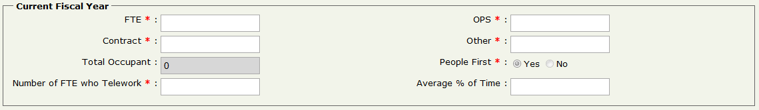
FL-SOLARIS PeopleFirst Indicator
Dept. of State Presentation
Leasing Reminders
REDM Reorganization
TRIRIGA Update
SOWs and Engagement Checklists
Annual Data Gathering Update
CBRE Presentation
In the next several months PeopleFirst will begin receiving building location/lease location data from FL-SOLARIS.
Agencies are required to indicate in FL-SOLARIS if an agency owned building houses staff.
Agency personnel offices will then identify which building each FTE is assigned to as their official headquarters location.
Information will be used for occupancy management, disaster management and emergency preparedness.

Slide 27
Annual Data Gathering Tracking
DMS will track and monitor agencies compliance and completion of:
Agency Owned and Leased Portfolio Management Plan (Business Case Analysis)
FL-SOLARIS updates
FL-SOLARIS FTE PeopleFirst indicator
Incomplete business case documentation will be returned to the agencies to correct.
Not submitting completed business case analysis will result in denial of approval of pending lease actions.
Dept. of State Presentation
Leasing Reminders
REDM Reorganization
TRIRIGA Update
SOWs and Engagement Checklists
Annual Data Gathering Update
CBRE Presentation

Slide 28
CBRE PRESENTATION
CONSTRUCTION MANAGEMENT
Dept. of State Presentation
Leasing Reminders
REDM Reorganization
TRIRIGA Update
SOWs and Engagement Checklists
Annual Data Gathering Update
CBRE Presentation

Slide 29
QUESTIONS
Dept. of State Presentation
Leasing Reminders
REDM Reorganization
TRIRIGA Update
SOWs and Engagement Checklists
Annual Data Gathering Update
CBRE Presentation

