Slide 1

State of Florida
Performance Management

Slide 2
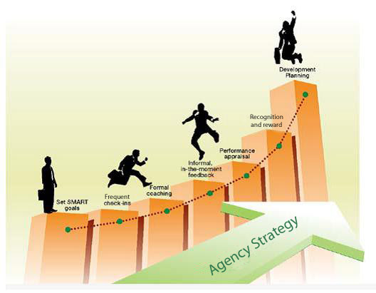

Performance Management
Performance Management
The process of motivating employees through setting goals, measuring progress, giving feedback, coaching for improved performance, and rewarding achievements.
Notes:
Question: So, why should we focus on performance management?
Performance management is arguably one of the most basic and important functions of management but also one of the more challenging.
In addition, factors such as changing workforce demographic, flatter and more matrix organizations, greater spans of management control, emphasis on project-based work, and a move away from more traditionally structured jobs to that of work roles that require more flexibility in adapting to the changing demands of the organization put an increased level of attention on how we manage our employees performance.
In other words, the work we do and how we do it is becoming more complex, resources more scarce, requiring more focused attention by employees on core functions that provide value to the organization and its stakeholders.
Unfortunately, for many years, the focus on good practice has been diluted by our concern for legal documentation of performance and not focused on employee development and performance. What I am suggesting today is that good performance management practice improves both the legal and performance aspects of employment.
I would further suggest that the state’s current approach to performance management requires more of a manager’s time to deal with problem employees than good ones! This can change through our execution of good processes, enhanced technology, and a focus on our people.

Slide 3
What is Performance Management?
Employee
performance expectations
connection of expectations to agency goals
definition of rating scale for each expectation
metric used to assess performance
plan for sustaining, improving or building on performance
Supervisor
Ongoing
Notes:
Ask: What is performance management. It is the continuous process of identifying, defining, and measuring the performance of employees’ and ensuring that the activities and outputs contribute to the goals of the organization.
In other words, performance management is both a goal-oriented and continuous process of evaluating and managing employees’ job and/or role performance.
It is goal oriented in the sense that it is purposeful on key outcomes and focuses on driving behaviors that contribute (or align) to the organization’s ultimate goals and mission.
It is an continuous or iterative process in that the goals or expectations that drive behaviors and outcomes are not static because the operating environment (e.g., laws, administration priorities, etc.), is dynamic. Consequently, performance expectations should be more adaptable to changes as well.

Slide 4
Performance Management
Isn’t:
one-way conversation
once-a-year event
focused on the past
tool for blame
reactive
surprise
Is:
collaborative
perpetual cycle
focused on present & future
tool for success
proactive
transparent
Notes:
How is performance management changing?
We are seeing organization’s move away from the more traditional telling or mandating approach of performance management to a more dynamic, collaborative approach, that focuses on more engagement and frequent communication with employees.
What is most important is that the evaluation process needs to be more impactful by focusing on continual improvement versus documenting past actions.
Let’s turn our attention to the various roles we need to consider in the performance management process – (1) supervisor, (2) reviewer, and (3) employee.

Slide 5
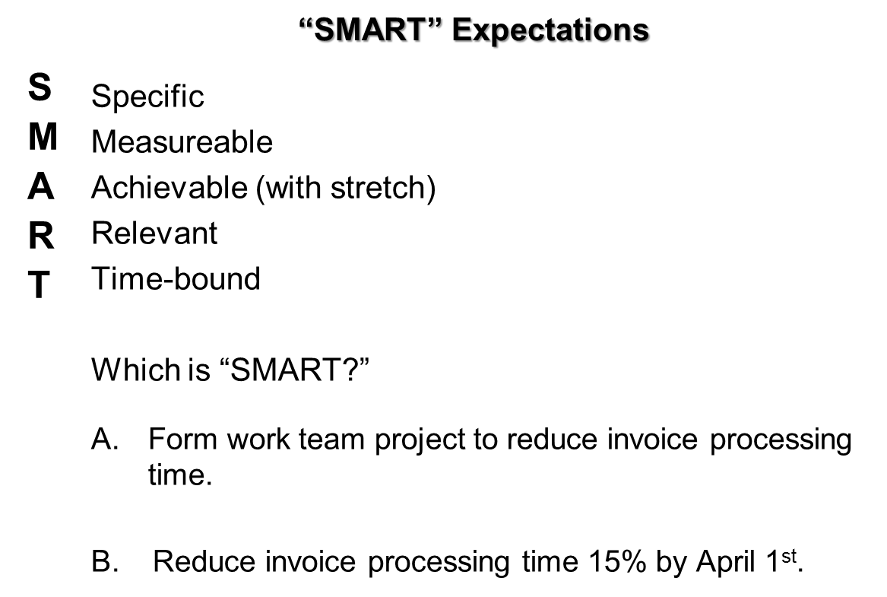
What are SMART Expectations?

Slide 6
Supervisor’s Role
The supervisor has the most critical role within performance management and also acts as the rater at the time of appraisal.
Because you must use ratings and comments that accurately reflect the performance of the employee, it is essential that you correctly understand and implement performance management.
Rater
The rater is the employee’s immediate supervisor.
Notes:
Supervisors play a critical role in the success of any performance related outcome because of their day-to-day involvement with employees. However, we know from research and experience the significant positive impact three primary performance elements (1) goal setting, (2) providing regular feedback, and (3) rater accuracy, if done well, by supervisors can have on employee and organizational outcomes.

Slide 7
Reviewer’s Role
A reviewer has two critical roles within performance management:
Verify that employee expectations are linked throughout the work unit with the agency goals.
Verify that ratings and comments are accurate and reflect a true picture of performance.
Reviewer
The reviewer is the supervisor’s manager or his/her designee.
Notes:
The reviewers role is equally important but stands apart from the supervisor’s role in that their purpose is to reduce variability among supervisors in order to improve the validity of the evaluation process.
In other words, the reviewers role is to evaluate the raters to verify consistent application of the SMART methodology as well as ensure the integrity of the performance management process. In order for any system to function properly there has to be a sense of fairness in how the process is carried out.
While not specifically stated, we also need to discuss the role of the employee. This is often overlooked but as important a role as any. While supervisors and reviewers seek to maintain the validity of the system or process, employees have the opportunity to utilize the expectations and feedback in a manner that enhances their skills and abilities or they can see it as a punitive mechanism. Ultimately, for the process to be meaningful the employee has to be invested in the process as much, if not more so, than managers.
In order to get their we have so show employees, managers, and organization’s the benefit or value in engaging in the process. Let’s take a look at benefits to each level.

Slide 8
What are the benefits?
The time and effort you invest in performance management will provide added value to the:
✓Employee
✓ Supervisor
✓ Agency
Value
Notes:
Improving our performance management processes and practice around setting specific, clear, and definable expectation, regular monitoring and giving of feedback provides added value to all levels of the organization.
Levels:
Employees
Supervisors
Organization
Let’s take a look at some of these benefits.

Slide 9

Value to Employee
B
Provides clear parameters: what & why
Recognition
Development
Feedback
Improvement
A
Clarity
Notes:
Provides clear parameters for employees, we know through various research studies that regular, targeted feedback helps employees calibrate their job performance similar to how feedback from a coach or teacher at regular intervals helps individuals focus on areas of importance or overcome skill/knowledge deficiencies or misunderstandings that negatively effect performance.
Another area of value for employees is the opportunity to reward and recognize high performers and identify those employees who require more development their knowledge and skills more quickly.
Through good expectation setting, evaluative monitoring and feedback, and a more objective rating of performance, employees perceive the process as more fair and equitable.
Question – what do you think employees want from the evaluation process?
Interestingly, employees crave quality, frequent, specific coaching and feedback to help them improve their performance

Slide 10
Value to Supervisor
provides more time to do the other duties of your job
allows you to handle small issues before they become big issues
reduces the need to micromanage
removes instances of being surprised or “the last to know”
Understanding
Notes:
Good performance management practice brings value to managers by:
Increasing the focus on outcomes versus tasks (this becomes extremely important with larger spans of control)
Due to increased frequency of feedback, it allows managers the opportunity to address performance issues while they are manageable and gives an employee a clear understanding of where they stand throughout the year versus one or two times a year.
Focuses your attention to relevant performance which can change the way you manage your employees

Slide 11
Value to Agency
Agency Goals
effectiveness & efficiency
productivity
morale
return on investment
Employee Expectations
Employee Expectations
Employee Expectations
Win-Win
Notes:
Ultimately, the benefit to the organization of good performance management practice lies in the outcomes it produces and the alignment of goals and expectations from top to bottom.
Here is a key point that I want to emphasize. No systems, measures, processes, or technology that can be deployed will be successful if, as leaders, each one of us is not committed to making performance management a priority in our organization by modeling the behaviors we want to see from our teams. The reality is this must be driven top down.

Slide 12
Summary of Performance
Management’s Value
Improve individual, unit/division, agency performance
Align individual performance with agency mission
Foundation of an integrated HR strategy
Identify top performers
Link performance with rewards
Create a culture of accountability, commitment, and performance
Win-Win

Slide 13
Performance Management
Initiative Objectives
Establish a reliable and consistent evaluation process methodology that includes front-end planning of individual expectations, linked to agency goals and provides employees feedback and coaching to improve performance.
Migrate all agencies to common evaluation date
Implement enterprise performance management system.
Recognize and reward high performing employees.
Establish foundation on which to build a human capital strategy.
Success

Slide 14
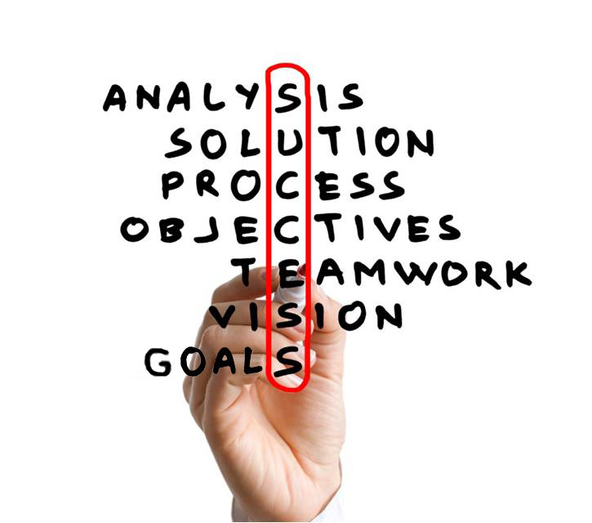
Success
Performance Management
– done correctly -- results in
success at all levels
of the agency.
Success

