Slide 1
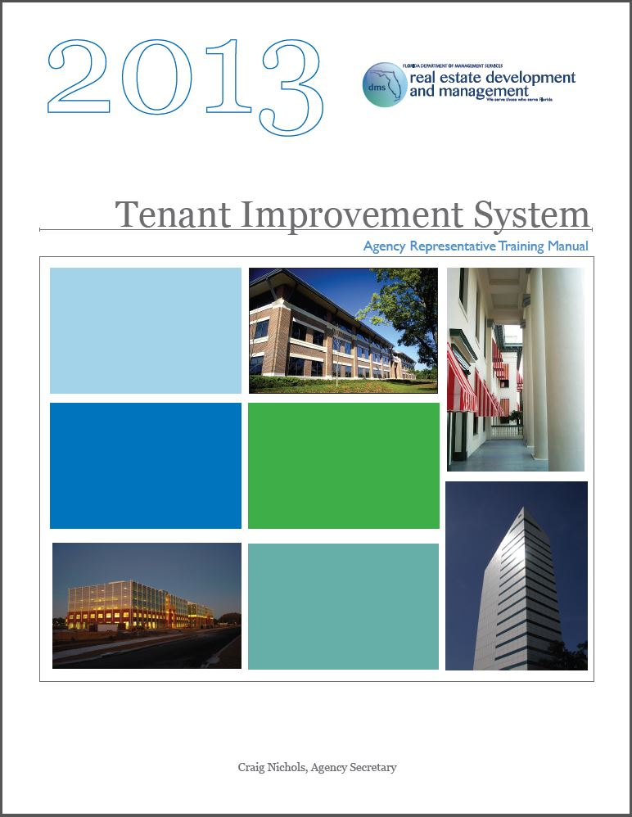
Tenant Improvement System
Agency Representative Training

Slide 2
INTRODUCTION
TI Administrator: Rahul S. Kamath, “Rah”
Construction Projects Consultant & Energy Specialist
rahul.kamath@dms.myflorida.com
850.922.7877 office | 850.212.8729 cell
Effective July 1, 2013, the Department of Management Services’ Real Estate Development and Management division is implementing an updated Tenant Improvement system. This presentation provides instructions, policies and requirements regarding the utilization of this system.
All tenant improvement requests must adhere to the guidelines set forth in the Tenant Improvement System - Agency Representative Training Manual. Please review, and direct any concerns or questions to tenant.improvement@dms.myflorida.com.

Slide 3
ABBREVIATIONS & DEFINITIONS
AR | Agency Representative
AR-A | Agency Representative - Alternate
AR-P | Agency Representative - Primary
CAA | Client Agency Agreement
DMS | Department of Management Services
NTP | Notice to Proceed
NTS | Notice to Secure
REDM | Real Estate Development & Management
TA | Tenant Allowable
TI | Tenant Improvement

Slide 4
TOPICS
Tenant Improvement System
Agency Representatives
Process Summary
Tenant Improvement Request Packet
Stages of the Tenant Improvement System
Background Checks & Approvals/Permits
Tenant Allowable Projects
Client Agency Agreement Projects

Slide 5
TENANT IMPROVEMENT SYSTEM
The Tenant Improvement System monitors and tracks tenant projects within DMS-managed facilities.
Tenant agencies must submit a formal request for review and obtain approval from DMS-REDM to make any modifications to their leased space.

Slide 6
AGENCY REPRESENTATIVES
Each agency must designate two ARs, an AR-P and an AR-A. These individuals will serve as the main points of contact for their agencies regarding all aspects of the TI system and will handle all aspects of the process (correspondence, questions, etc.).
Agency Representative Responsibilities:
Consult with and receive approval from the FM regarding all projects prior to submission of the TI request packet.
Complete and submit the TI request packet.
Secure and submit background checks and approvals/permits.
Coordinate all project-related activities with FM and contractor(s).
Ensure all guidelines, protocols and rules are adhered to during project execution.
Coordinate all project close-out activities.
Provide all required close-out documentation to REDM.

Slide 7
PROCESS SUMMARY
ARs must complete the TI system training and provide signed acknowledgement forms.
Agency desires to make changes or modifications to its space. A list of TA tasks provides the types of projects that may be self-performed. Projects determined not TA will require a CAA.
Agency consults and receives approval from the FM for project(s) prior to submission of the TI request packet.
AR completes the TI request packet:
    4048 - Tenant Improvement Request Form - completed and signed
    4048A - Tenant Improvement Guidelines - completed and signed
    Before/After Drawings - marked up and notated
    Quotes (in accordance with section 287.057, F.S., and Chapter 60A-1.002, F.A.C.):
        Less than or equal to $2,500: one quote
        $2,501-$35,000: two quotes (minimum)
        More than $35,000: competitive solicitation

Slide 8
PROCESS SUMMARY (cont.)
    ARs submit TI request packet to tenant.improvement@dms.myflorida.com.
    TI request packet is processed into the TI system and submitted for review and approval. A notification email is sent to the ARs confirming initiation of the workflow process.
    When the TI request has been approved, a Notice to Secure (NTS) Background Checks & Approvals/Permits letter is issued authorizing the ARs to secure and submit background checks (always required) and approvals/permits (as required).
    When the NTS letter requirements have been fulfilled, a Notice to Proceed (NTP) w/ Commencement of Work letter is issued authorizing the agency to execute the project.
    ARs coordinate project execution with FM and contractor(s).
    ARs coordinate inspections and final-walkthroughs when the project is completed.
    ARs provide all required close-out documentation to REDM.
    The TI request is closed out of the system.

Slide 9
TENANT IMPROVEMENT REQUEST PACKET
4048 - Tenant Improvement Request Form
  Main form required to submit a TI request.
4048A - Tenant Improvement Guidelines
  Guidelines regarding definitions, approval, and responsibilities of REDM, tenant agency and contractors, with regards to the TI system.
4106 - Agency’s Authorized Signature Authority
  Lists all individuals within an agency authorized to provide signatures on paperwork submitted to REDM. This form must be renewed annually at the beginning of each fiscal year (July 1).
Tenant Allowable Tasks
  Provides a list of common improvements that may be self-performed.

Slide 10
TENANT IMPROVEMENT REQUEST PACKET (cont.)
Criminal Background Check Process
  Provides details regarding criminal background checks for access to DMS-managed facilities by contractors.
  Contractors will not be allowed access to DMS-managed facilities without a current approval. Contractors must possess approved identification, along with a copy of the approval notice provided by DMS.
Additional Items (provided by ARs)
  Quotes
    Less than or equal to $2,500: one quote
    $2,501-$35,000: two quotes (minimum)
    More than $35,000: competitive solicitation
  Before/After Drawings
  Schedule of Work

Slide 11
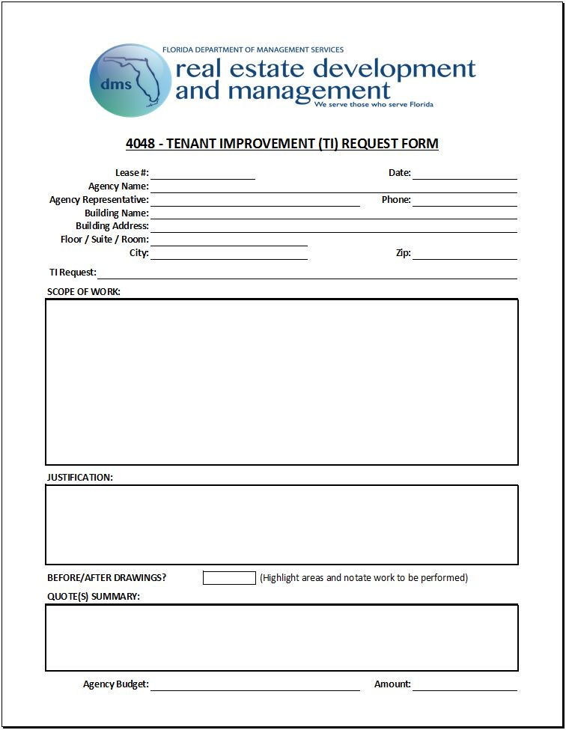
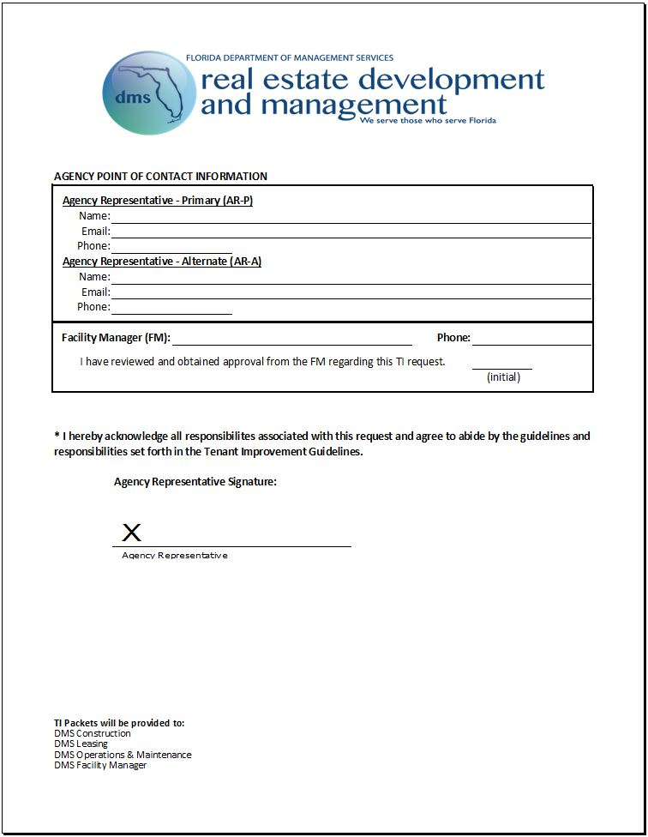
TENANT IMPROVEMENT REQUEST PACKET - 4048

Slide 12
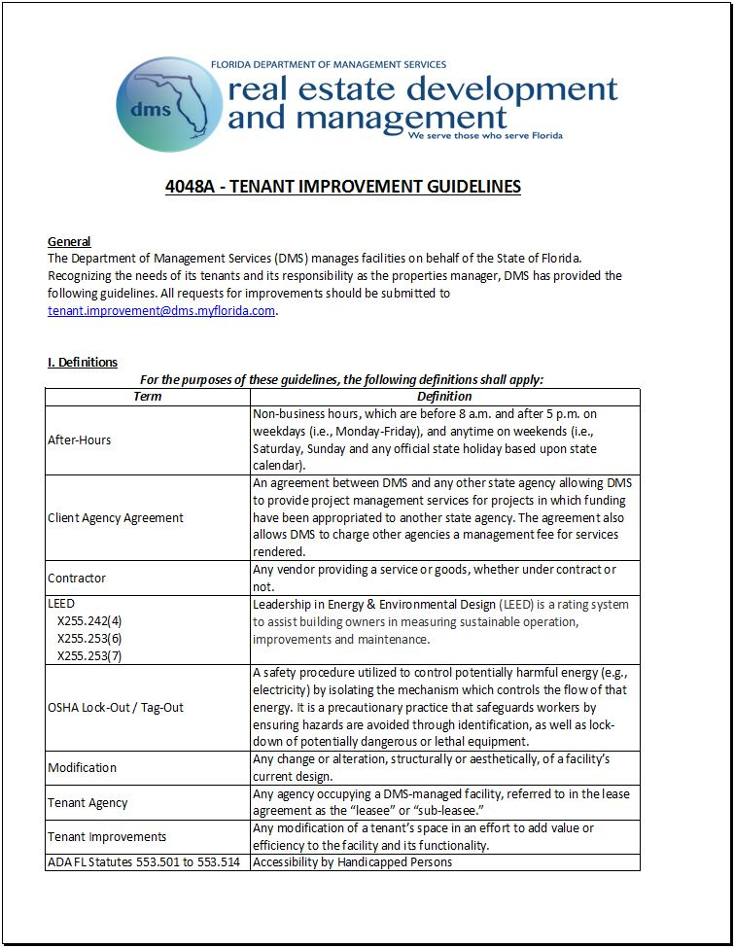
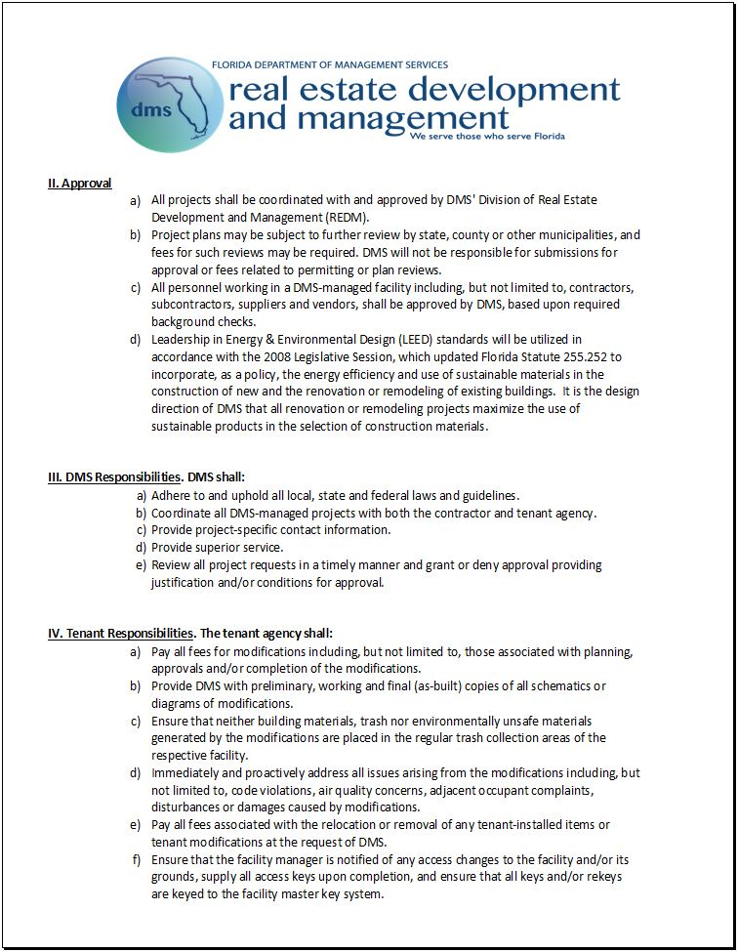
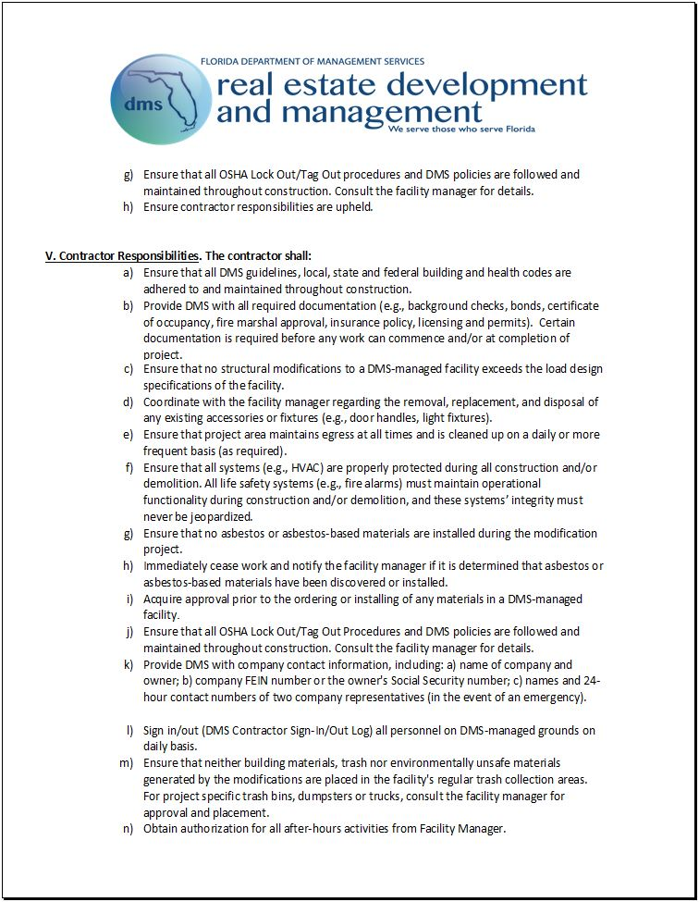
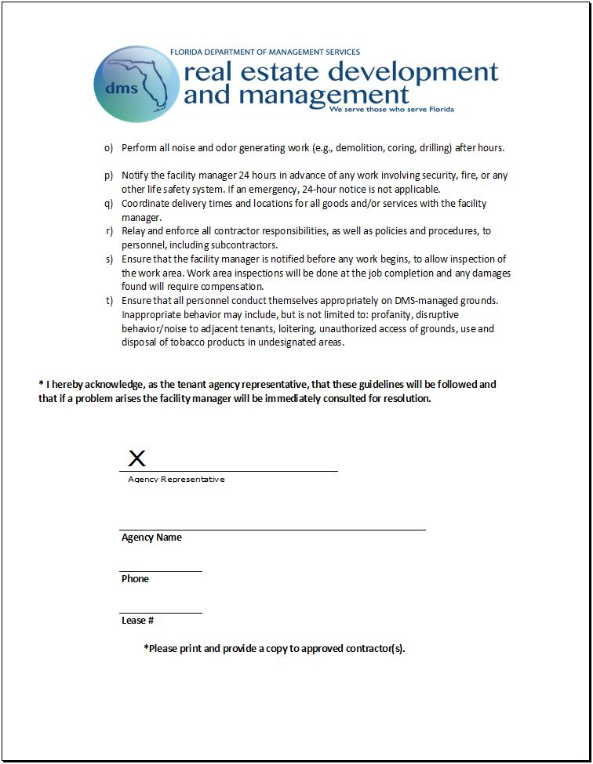
TENANT IMPROVEMENT REQUEST PACKET - 4048A

Slide 13
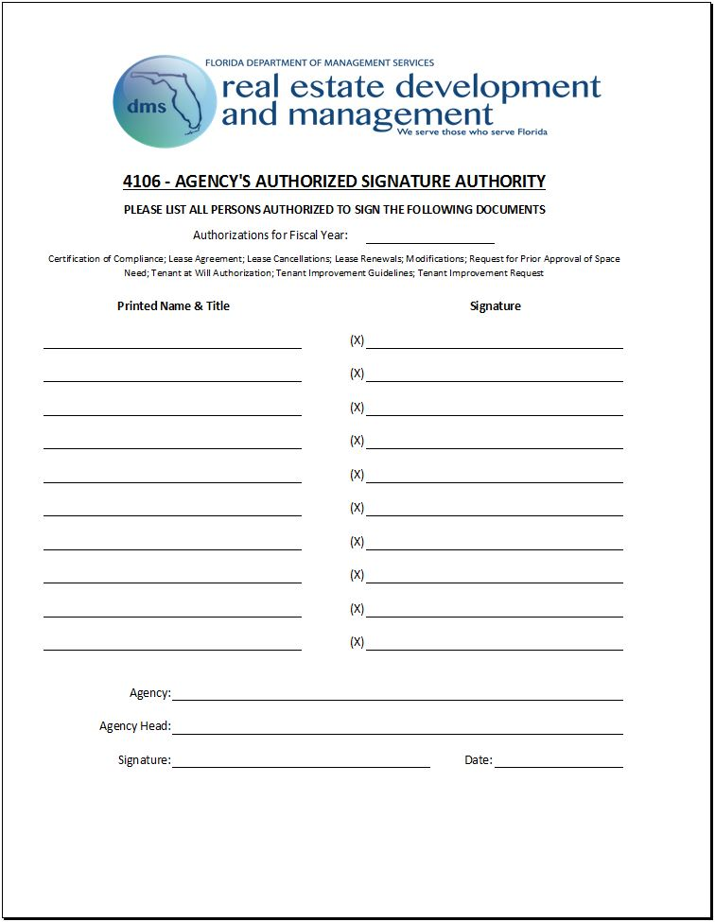
TENANT IMPROVEMENT REQUEST PACKET - 4106

Slide 14
STAGES OF THE TENANT IMPROVEMENT SYSTEM
Stage 1: Inception & Approval
  Tenant agency consults the FM regarding TI request.
  ARs are contacted to submit TI request packet.
  ARs prepare TI request packet (4048, 4048A, quotes, before/after drawings, etc.) and submits to tenant.improvement@dms.myflorida.com.
  TI request packet is processed into the TI system and submitted for review and approval. A notification email is sent to the ARs confirming initiation of the workflow process.
  The TI request will be Approved, Declined or Suspended.
    If a project is Approved, Stage 2 begins.
    If a project is Declined, the agency may escalate the request.
    If a project is Suspended, additional information is required. Once the requested information is received, the request is resubmitted for review and approval.

Slide 15
STAGES OF THE TENANT IMPROVEMENT SYSTEM (cont.)
Stage 2: Project Pre-Execution
  The NTS letter is issued authorizing the ARs to secure and submit background checks (always required) and approvals/permits (as required).
  ARs proceed with fulfilling all requirements of the NTS letter.
  The NTP letter is issued authorizing the ARs to execute project.
Stage 3: Project Execution
  Agency coordinates project execution with FM and contractor(s).
  Project is executed.
Stage 4: Project Close-Out
  Inspection(s) are performed by all necessary entities (FM, State Fire Marshal, etc.).
  Final walk-through is performed by REDM.
  A notification email is sent out verifying project completion.
  TI request is closed out.

Slide 16
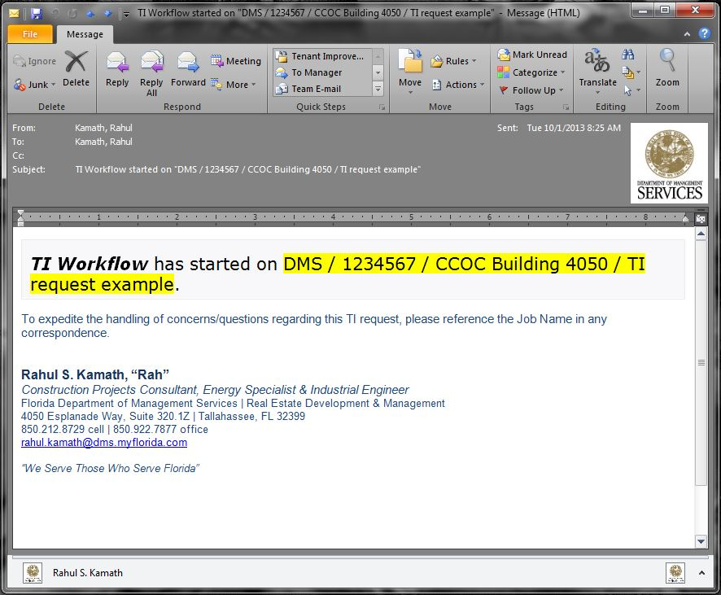
TI WORKFLOW NOTIFICATION EMAIL

Slide 17
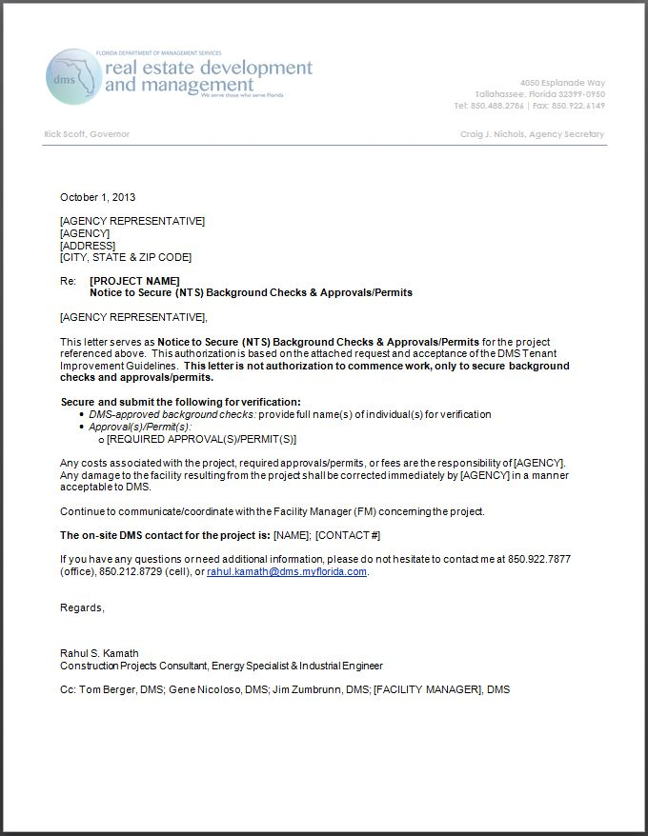
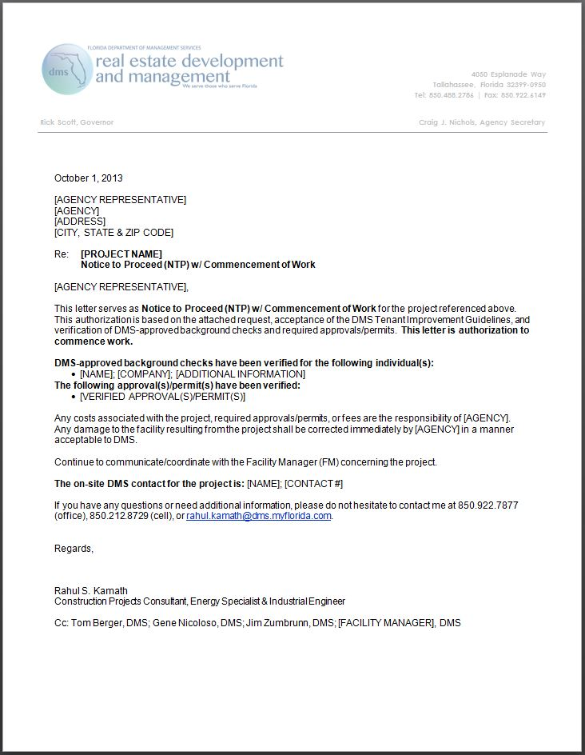
NTS & NTP LETTERS

Slide 18
BACKGROUND CHECKS & APPROVALS/PERMITS
Background Checks
  DMS requires background checks for access to all DMS-managed facilities. Background checks are always required.
Approvals/Permits
  Certain types of projects require approvals/permits. DMS will assist with identification of required approvals/permits for projects; however, it is the agency’s responsibility to coordinate with local, city and state building departments to secure all required approvals/permits for a project prior to project execution.

Slide 19
TENANT ALLOWABLE PROJECTS
Tenant Allowable Projects
Tenant allowable projects are classified as minor and may be self-managed by the requesting agency. Projects classified as major are managed by REDM’s construction group and require a CAA. A list of common TA projects is provided with the TI request packet.
Architectural | Data / Telecommunications | Electrical | Mechanical
Repaint Existing Interior Walls & Ceilings Repaint Existing Interior Doors Replace Existing Carpet & Tile Replace Existing Sheet Vinyl & Similar Products Replace Existing Interior Doors & Glazings Replace Modular Office Furniture | Replace and/or Install Data Cabling Replace and/or Install Data Equipment Replace and/or Install Telecommunications Cabling Replace and/or Install Telecommunications Equipment | Relocate or Replace Existing Light Fixtures Relocate Existing Electrical Circuits Install New Power Outlets Replace or Install Electrical Equipment (Excluding Emergency Generators and Transfer Switches) | Relocate Existing HVAC Diffusers Relocate Existing HVAC Sensors Relocate Existing Sprinkler Heads

Slide 20
CLIENT AGENCY AGREEMENT PROJECTS
Client Agency Agreement Projects
Tenant improvement requests classified as major require a CAA and are managed by REDM’s construction group, where DMS effectively assumes the role of project manager and handles all aspects (contracting, project management, etc.) of the project from start to finish. A fee is paid to DMS based on the total project cost. For more details, DMS’ construction group should be contacted directly.

Slide 21
ADDITIONAL INFORMATION
Exceptions to Quotes Requirements
  If a contractor has been awarded either a State Term Contract or DMS Contract, only one quote is required. The contract # should be referenced with the quote in the TI request.
Timelines
  TI request submission to workflow initiation: 5 business days
  TI request submission to decision: 5-10 business days
  TI request approval to NTS issuance: 5 business days
  NTS to NTP issuance: 5 business days from fulfillment of NTS requirements

Slide 22
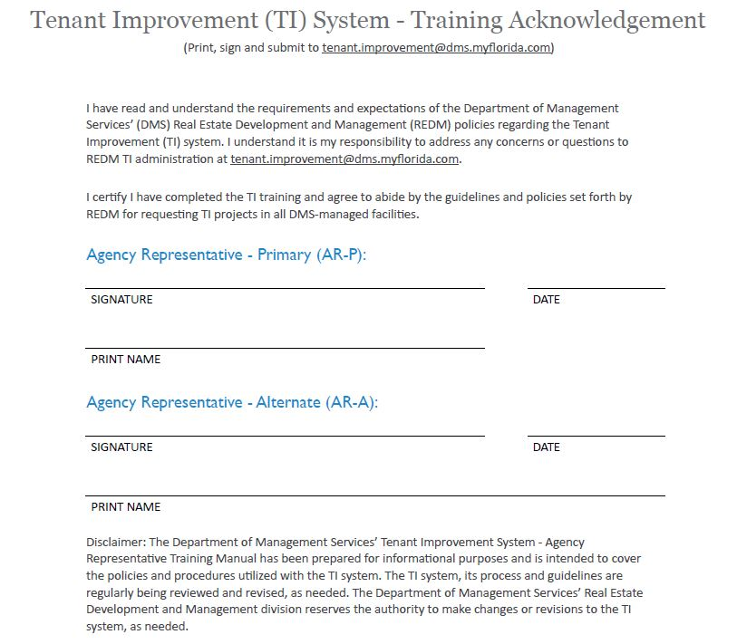
TRAINING ACKNOWLEDGEMENT

Slide 23
